Slide 1

Optimizing Cold Starts in FaaS with Machine Learning
Saury Pande
Chair of Computer Architecture and Parallel Systems,
Technical University of Munich (TUM)
Munich: 25.05.2023
Notes:
1

Slide 2
Outline
Function as a Service (FaaS)
Problem of Cold Start
Existing Approaches
Our Contribution
Methodology
Experimental Setup
Results
Conclusion and Future Work

Slide 3
Outline
Function as a Service (FaaS)
Existing Approach
Our Contribution
Methodology
Experimental Setup
Results
Conclusion
Future Work

Slide 4
Outline
Function as a Service (FaaS)
Existing Approach
Our Contribution
Methodology
Experimental Setup
Results
Conclusion
Future Work

Slide 5
What is Serverless?
Als Grundlage dient der Corporate Design Style Guide der TUM. Die Präsentationsvorlage ist auf gute Lesbarkeit und klare Darstellung von Informationen optimiert.
Dr. rer. nat. Erika Mustermann (TUM) | kann beliebig erweitert werden | Infos mit Strich trennen
5

Slide 6
Function as a Service (FaaS)
Bounded-time functions with no persistent state among invocations
Upload code, get an endpoint, and go
Advantages:
Lower costs (pay per use)
Scalability (zero to infinite elasticity)
High availability
No worry about servers (Provisioning, Reserving, Configuring, Patching, Managing)
6

Slide 7
Cold Starts
A new container is initialized which involves all the processes of setting up of container environment depending upon the function requirements.
Memory and Computing resources like vCPUs are allocated.
Function along with all its dependencies like libraries are loaded.
The function is then executed and returns the result as a response to the request
7

Slide 8
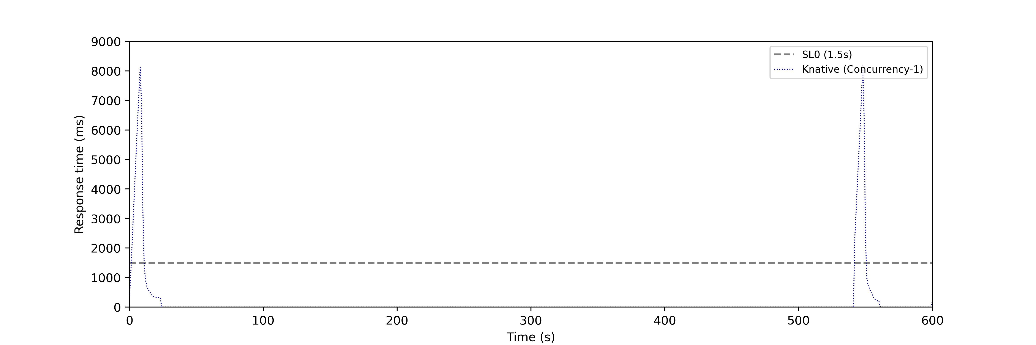
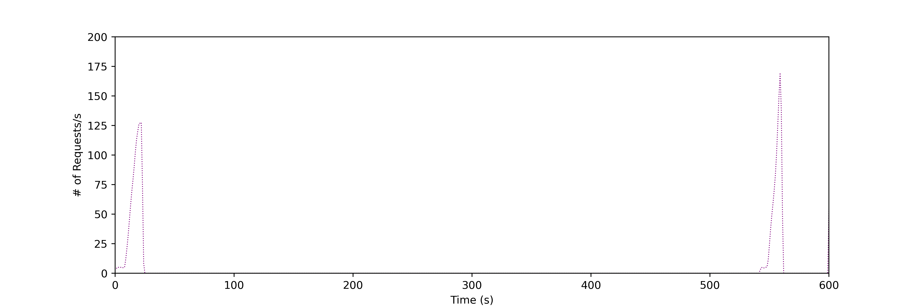
Drawbacks of Cold Starts
Increase in Response Time Latency
Increase in Cost
Inefficient Resource Utilization
Very bad user experience
8
Notes:
This whole process typically range from 0.2 to few seconds resulting in delayed response

Slide 9
Existing Solutions
Solutions that are proposed to reduce cold start are broadly classified into two categories :
Reducing cold start time
Container Reusing Technniques - Snapshot technique (FaaSnap)
Code Optimization Techniques
Preventing occurance of cold start
Fixed Keep Alive Policy
Setting minimum containers to be always active
Pre-warming Techniques
9

Slide 10
Problems with Existing Approaches
Approaches that try to reduce cold start delay are not able to eliminate cold starts and user still experience significant delay in response.
Most approaches are not SLO (Service Level Objectives) aware.
In most solutions evaluation against real production traces missing.
Did not consider both concurrency and number of active instances.
Testing against default KPA and KPA with concurrency as 1 like Amazon Lambda.
Fixed keep alive policy results in higher costs
Missing model retraining after performance degradation.
10
Notes:
Solutions which try to reduce the overall cold start time are language dependent.
There is a limit to which the time can be reduced
talk more about related approach shortcomings

Slide 11
Our Contribution
Trained and tested ML and Deep Learning Models to determine effective invocation forecasting mechanism.
Developed a tool SmartOpt to pre-create container instances.
Developed a Load generator tool to simulate the functions invocation behavior.
Evaluate our strategy with existing available solutions like default Knative Pod Autoscaler (KPA) and KPA with concurrency one.
Analysed response time, SLO violations, requests served, and costs
11

Slide 12
Timeseries Models
ML Models
FFT (Fast Fourier Transform)
Prophet
Deep Learning Model
N-BEATS
N-HITS

Slide 13
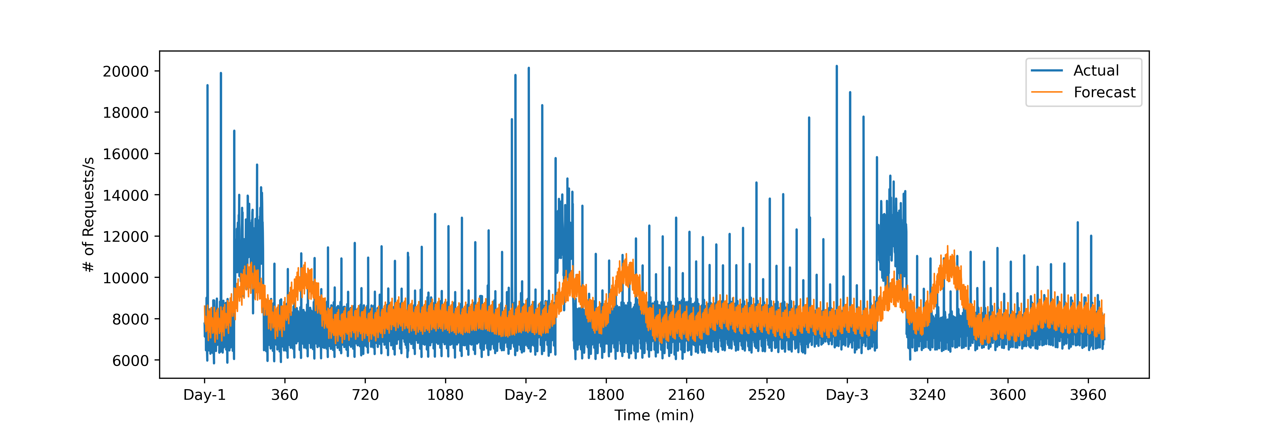
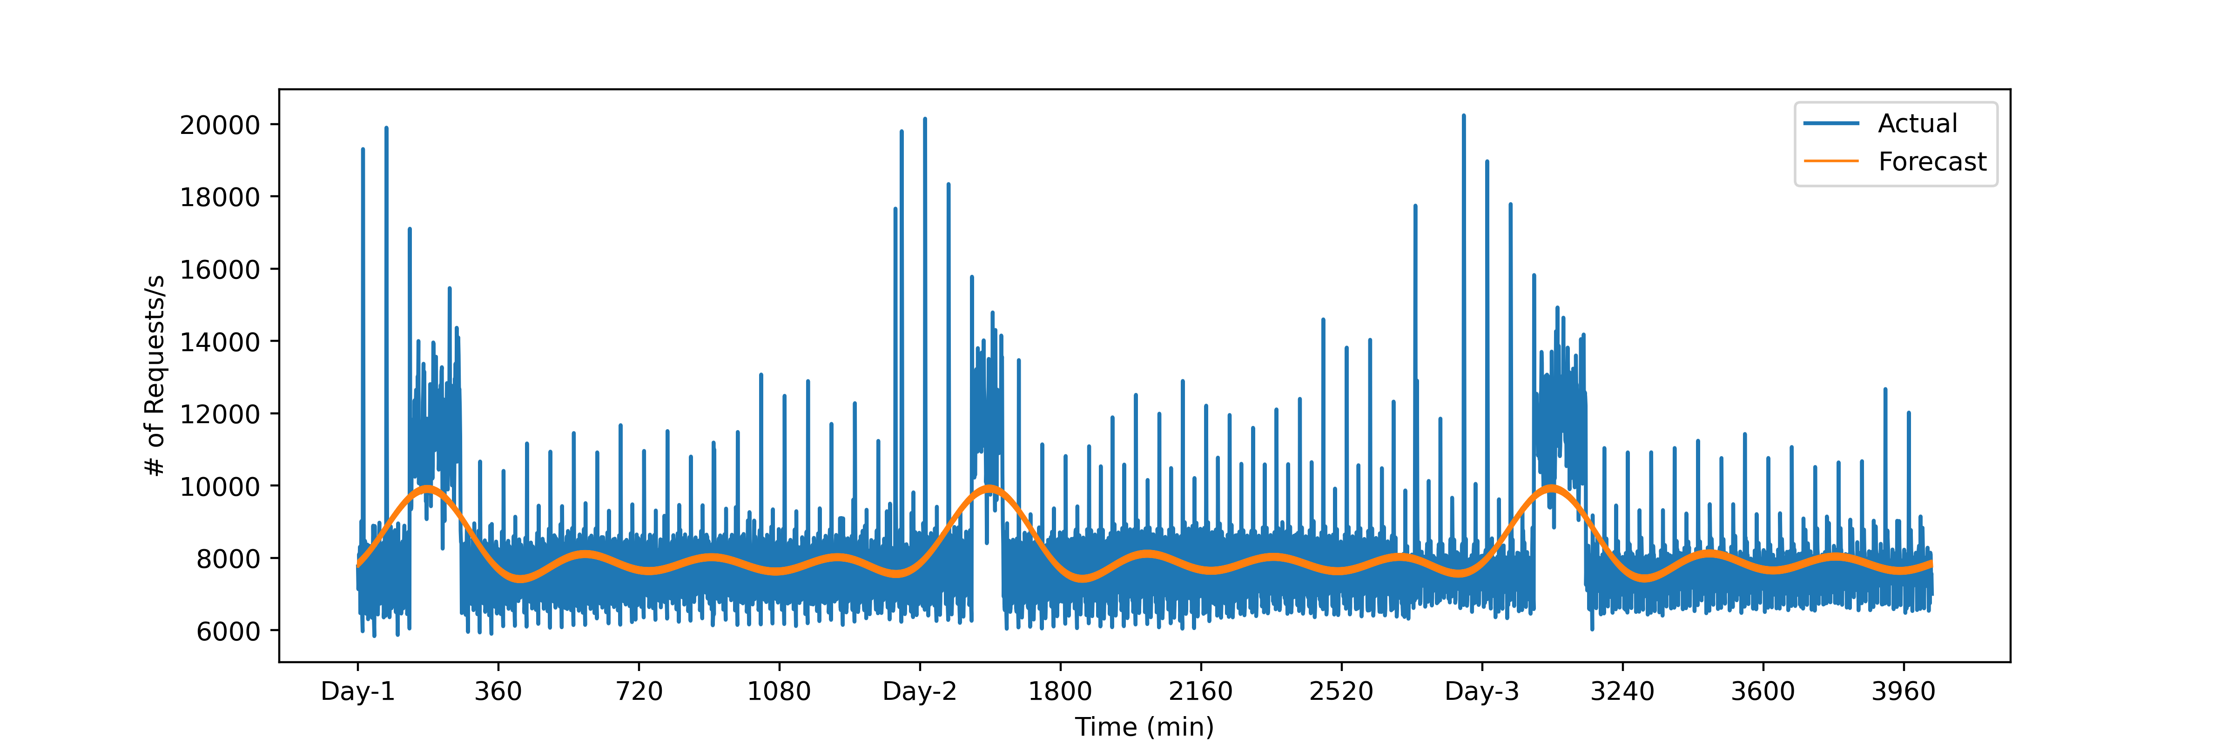
ML Models Forecasting
Fig 1: FFT
Fig 2: Prophet

Slide 14
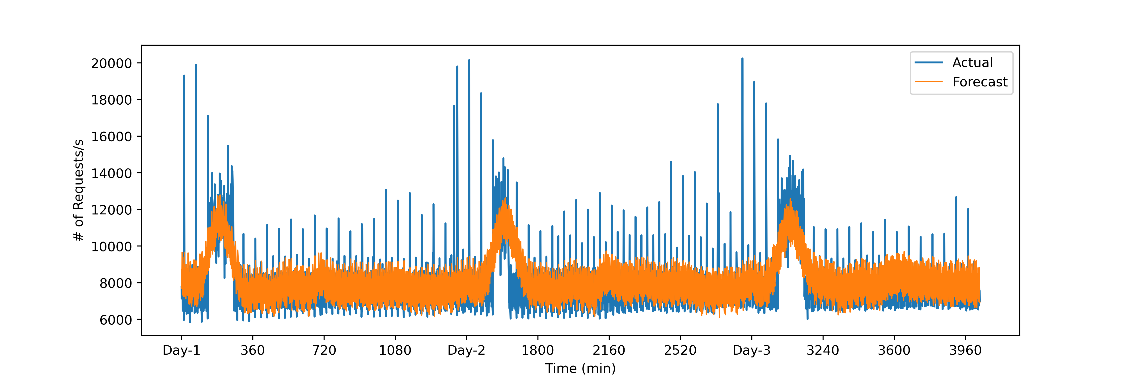
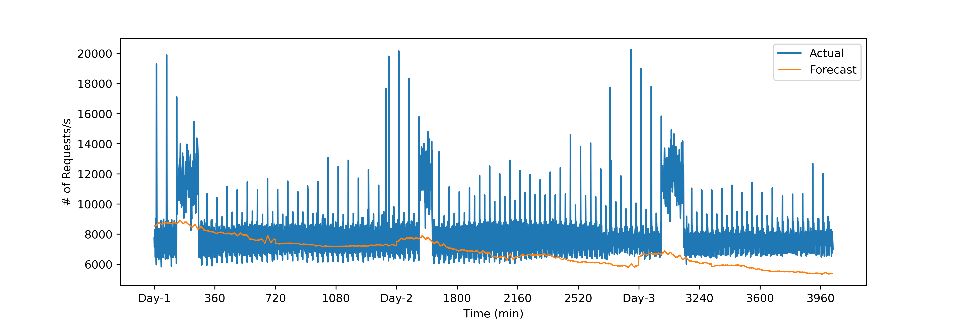
Deep Learning Models Forecasting
Fig 1: N-BEATS
Fig 2: N-HITS

Slide 15
Training time of Timeseries Models

Slide 16
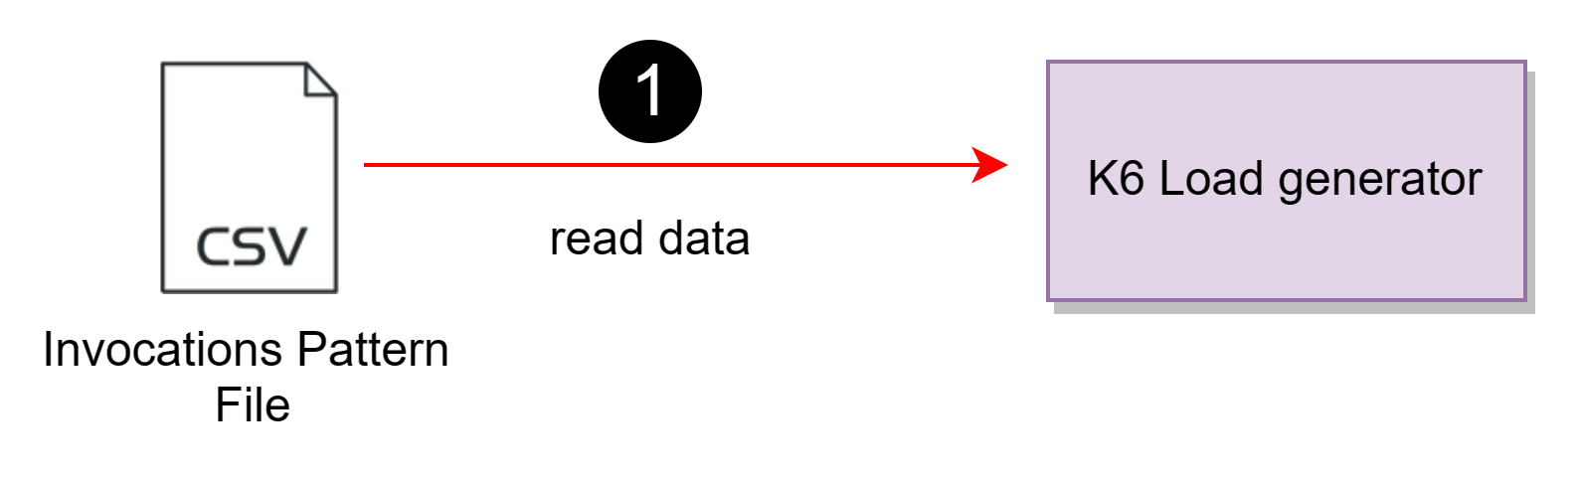
Load Generator Architecture

Slide 17
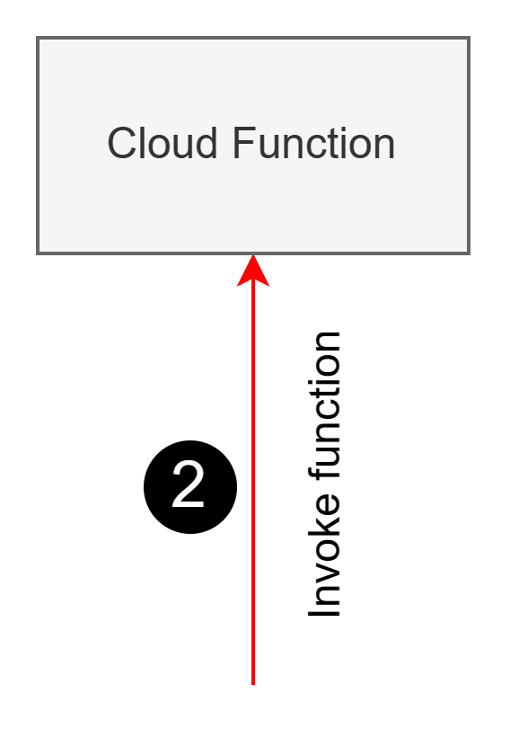
Load Generator Architecture

Slide 18
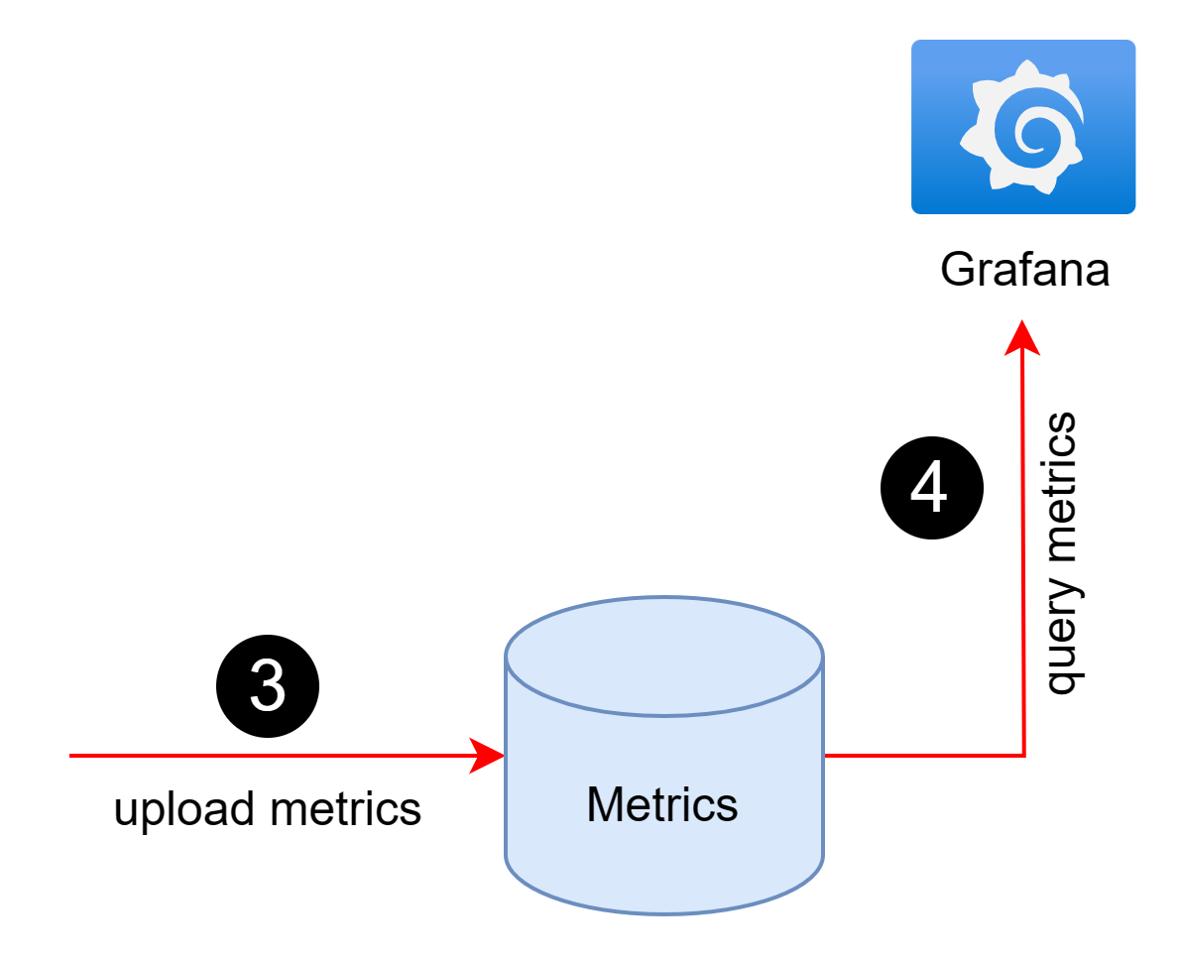
Load Generator Architecture

Slide 19
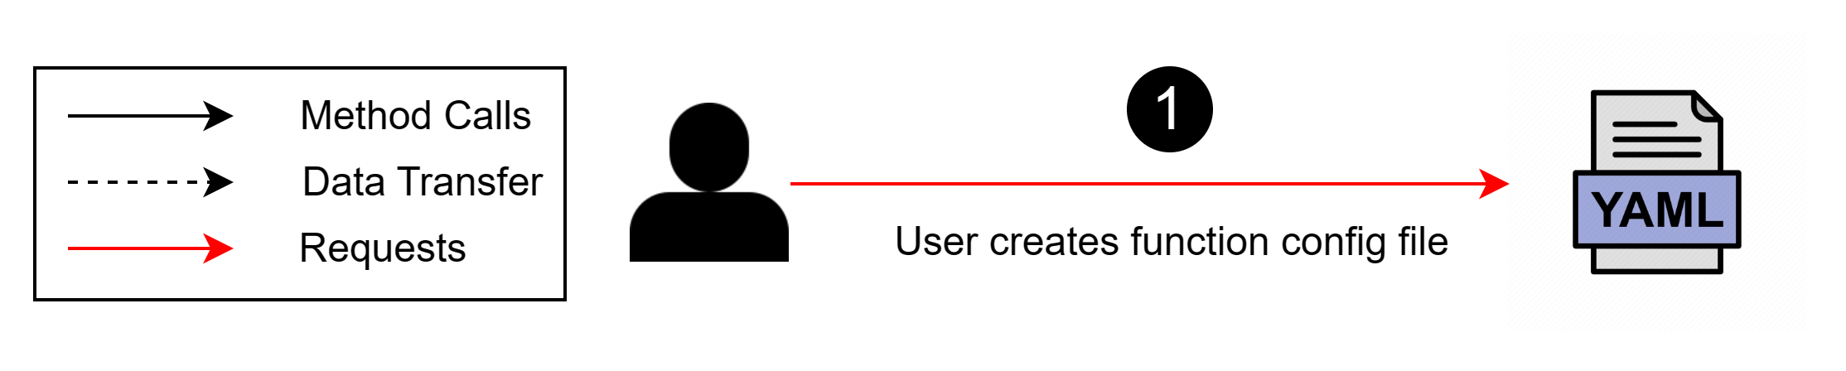
SmartOpt Architecture and Workflow

Slide 20
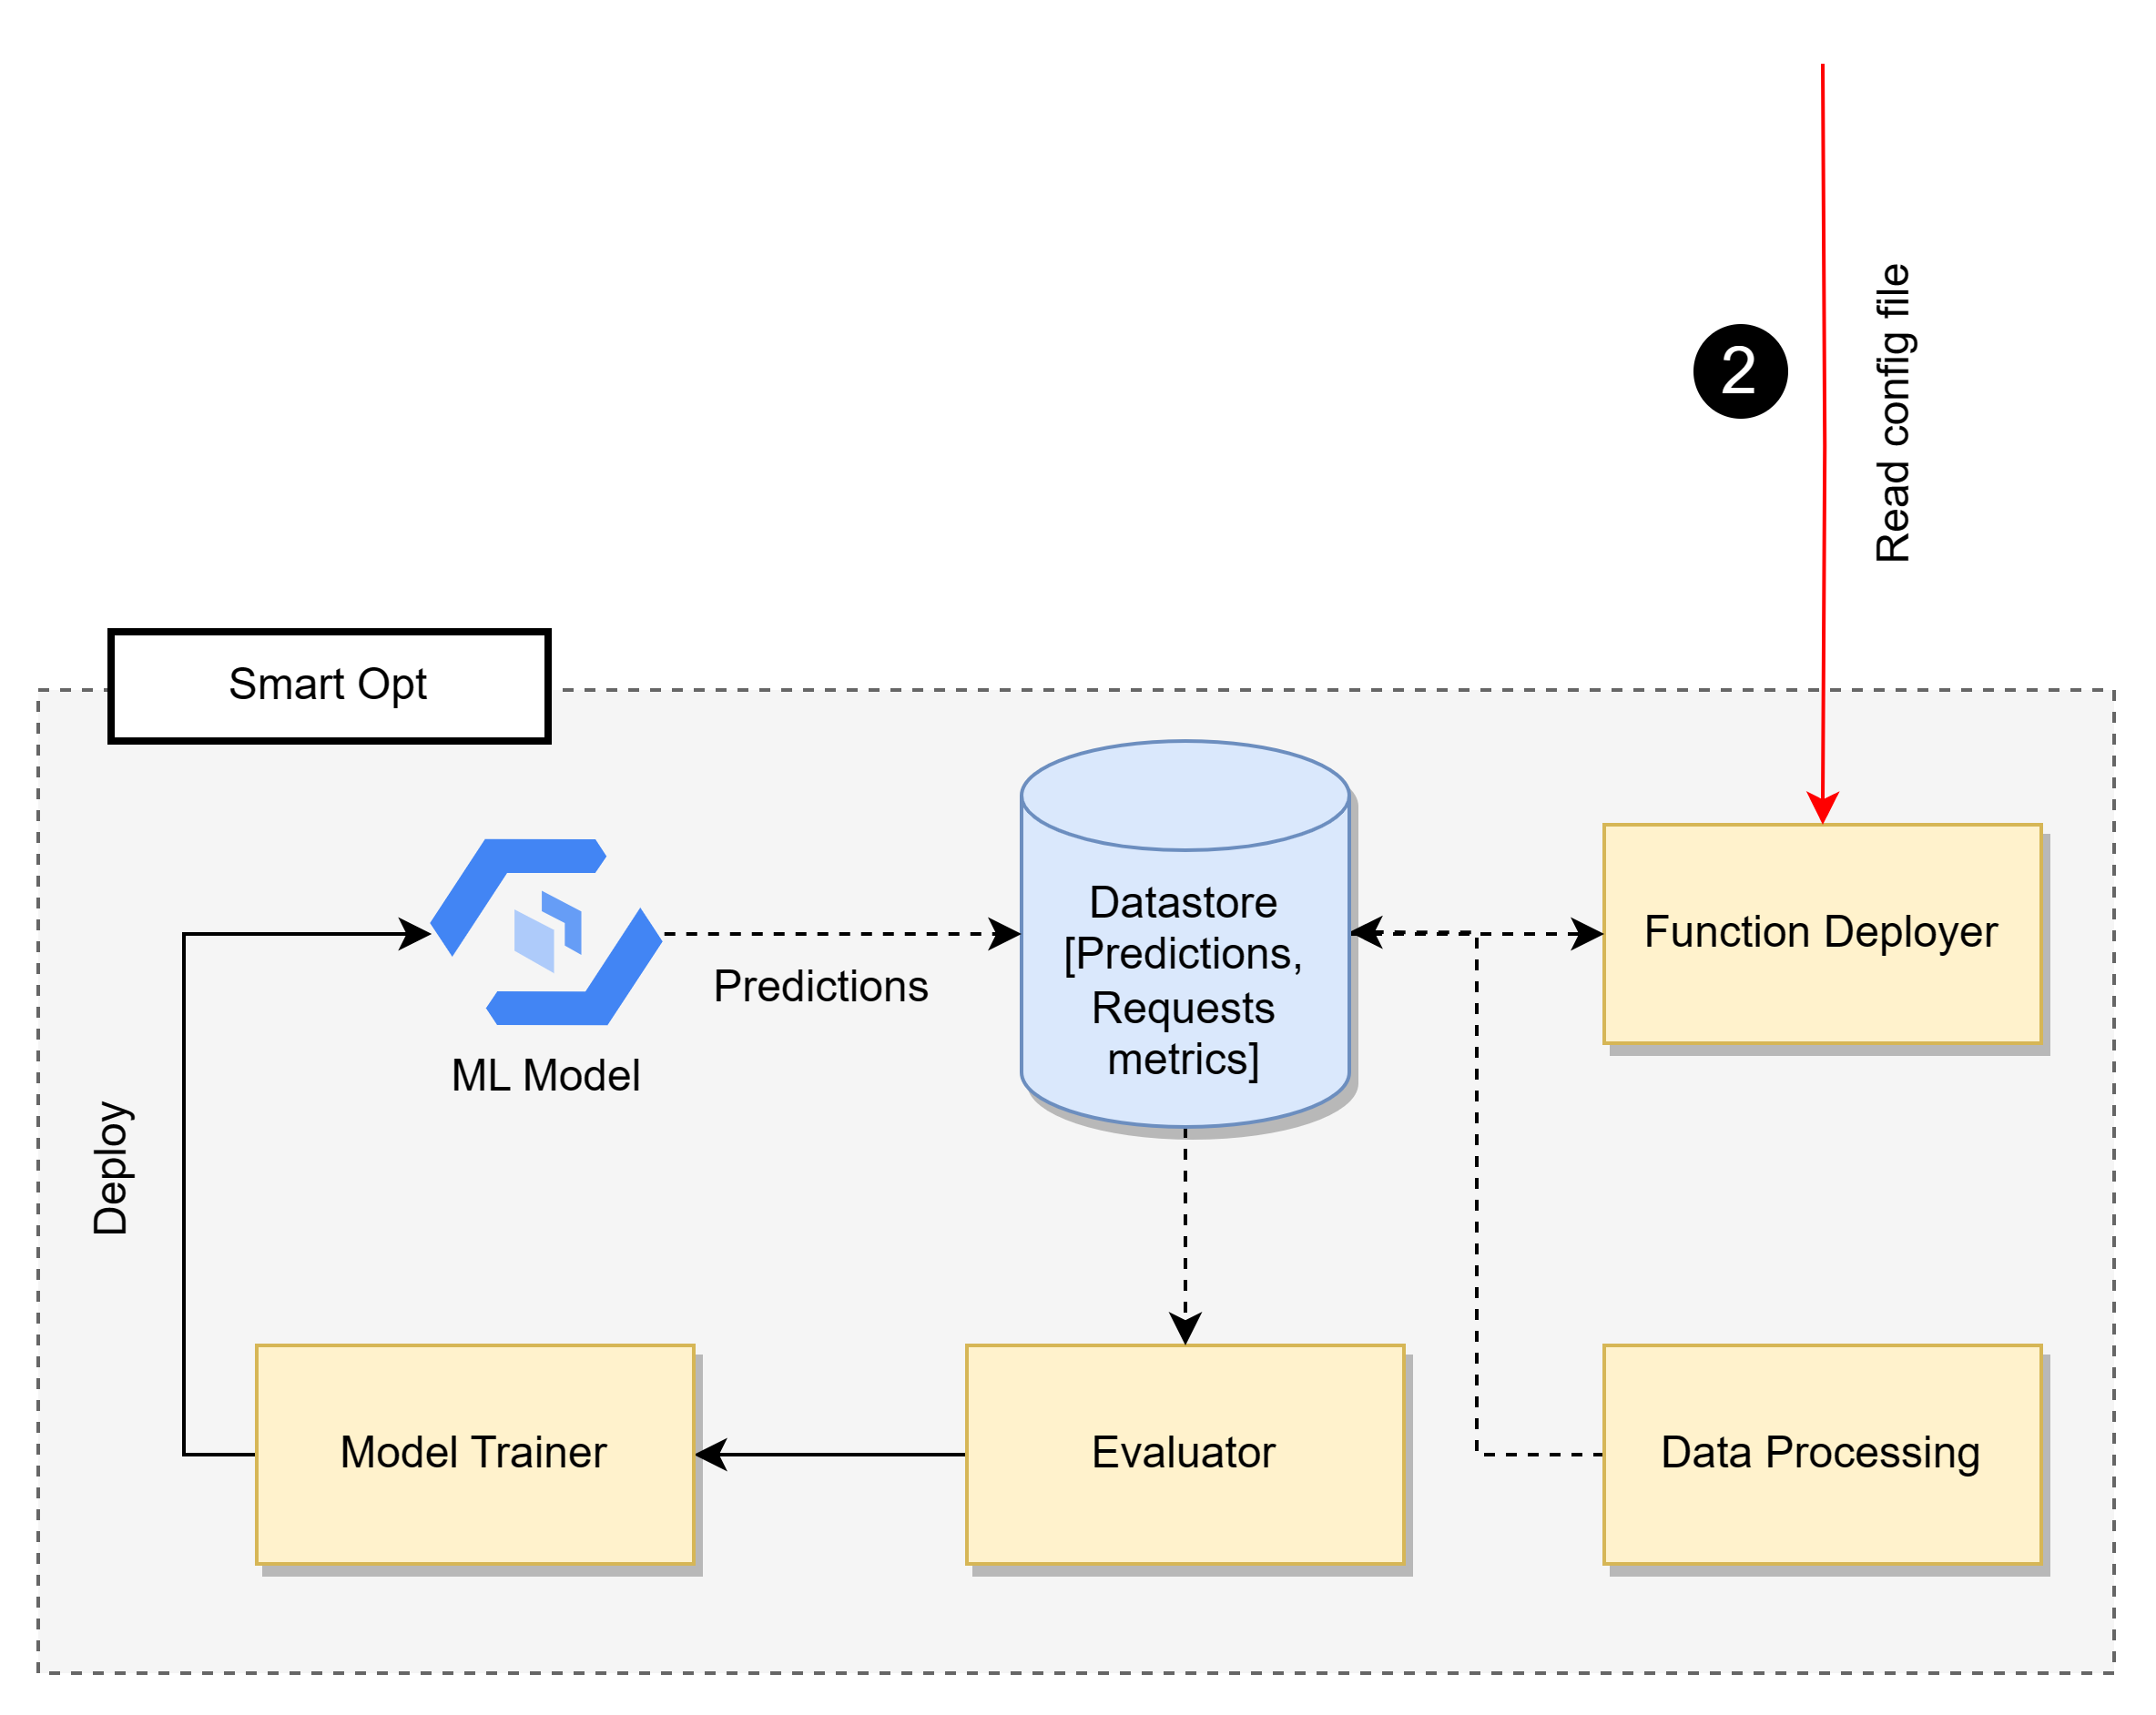
SmartOpt Architecture

Slide 21
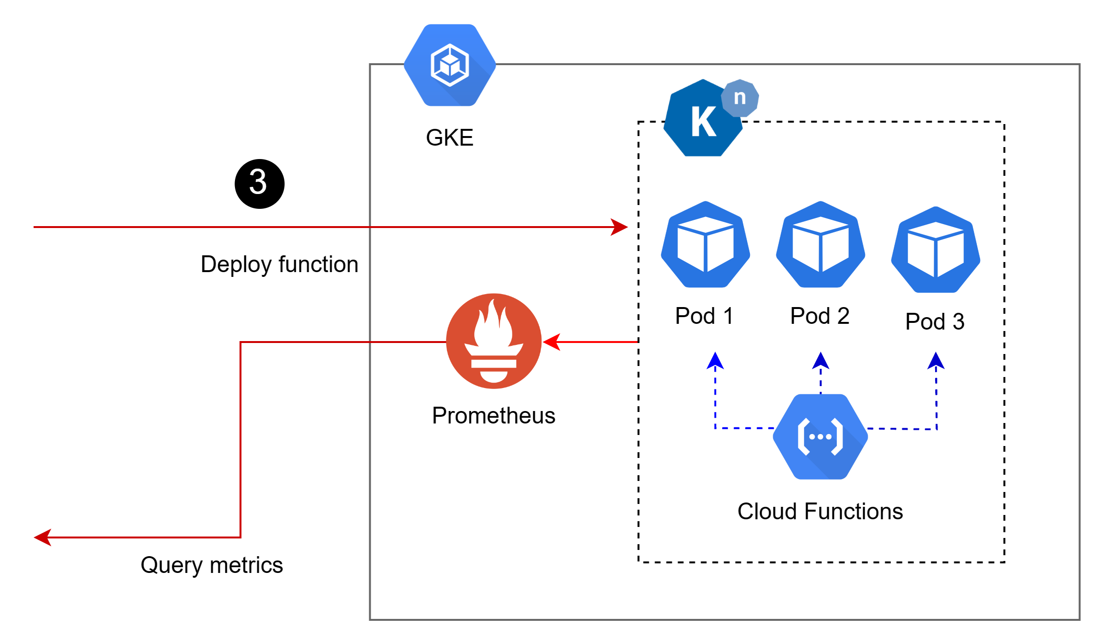
SmartOpt Architecture

Slide 22
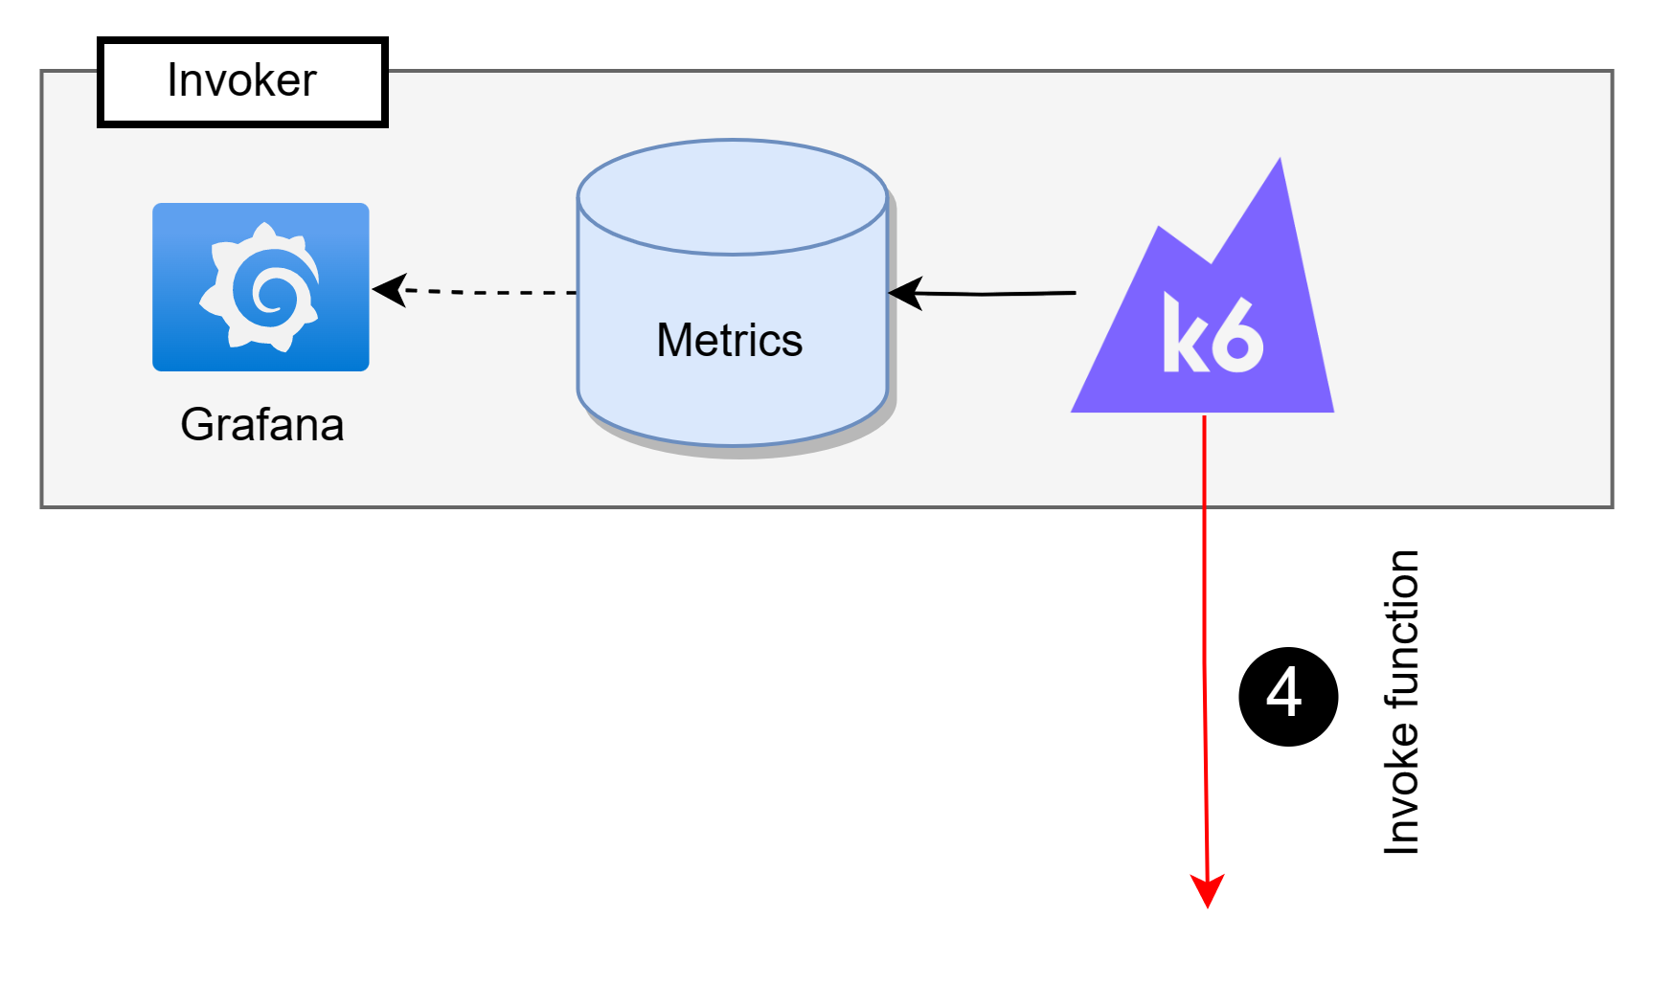
SmartOpt Architecture

Slide 23
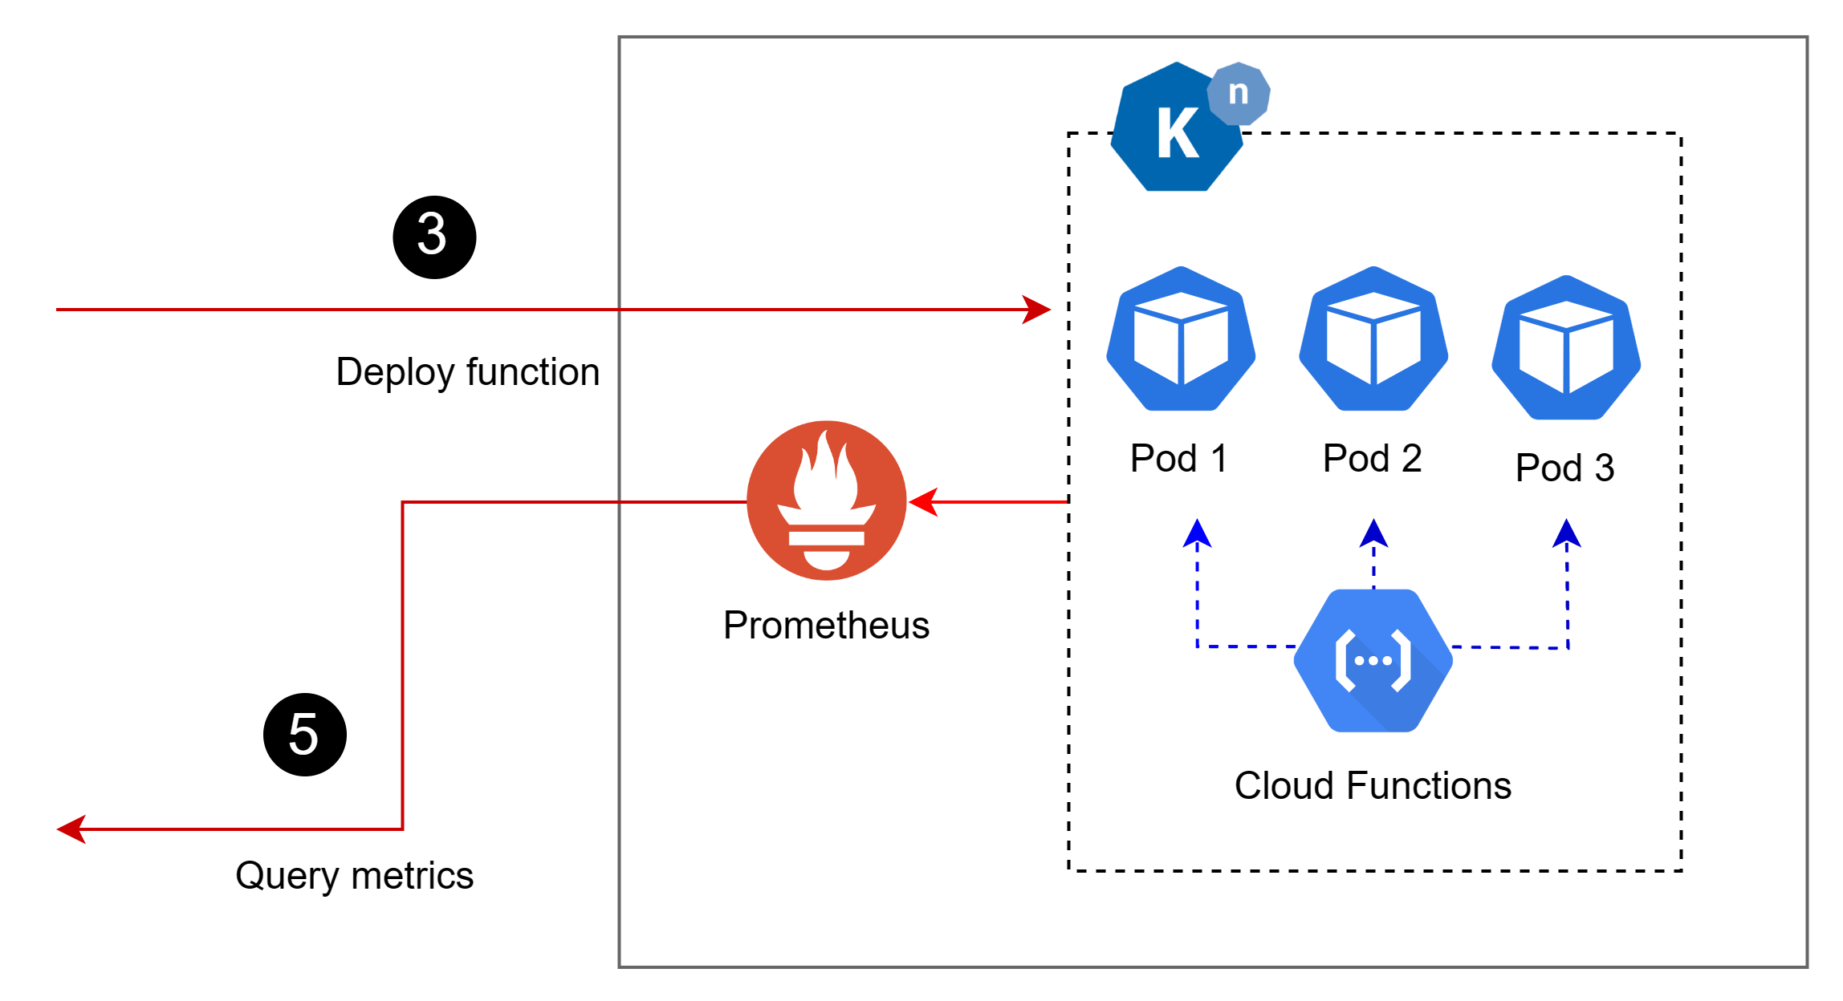
SmartOpt Architecture

Slide 24
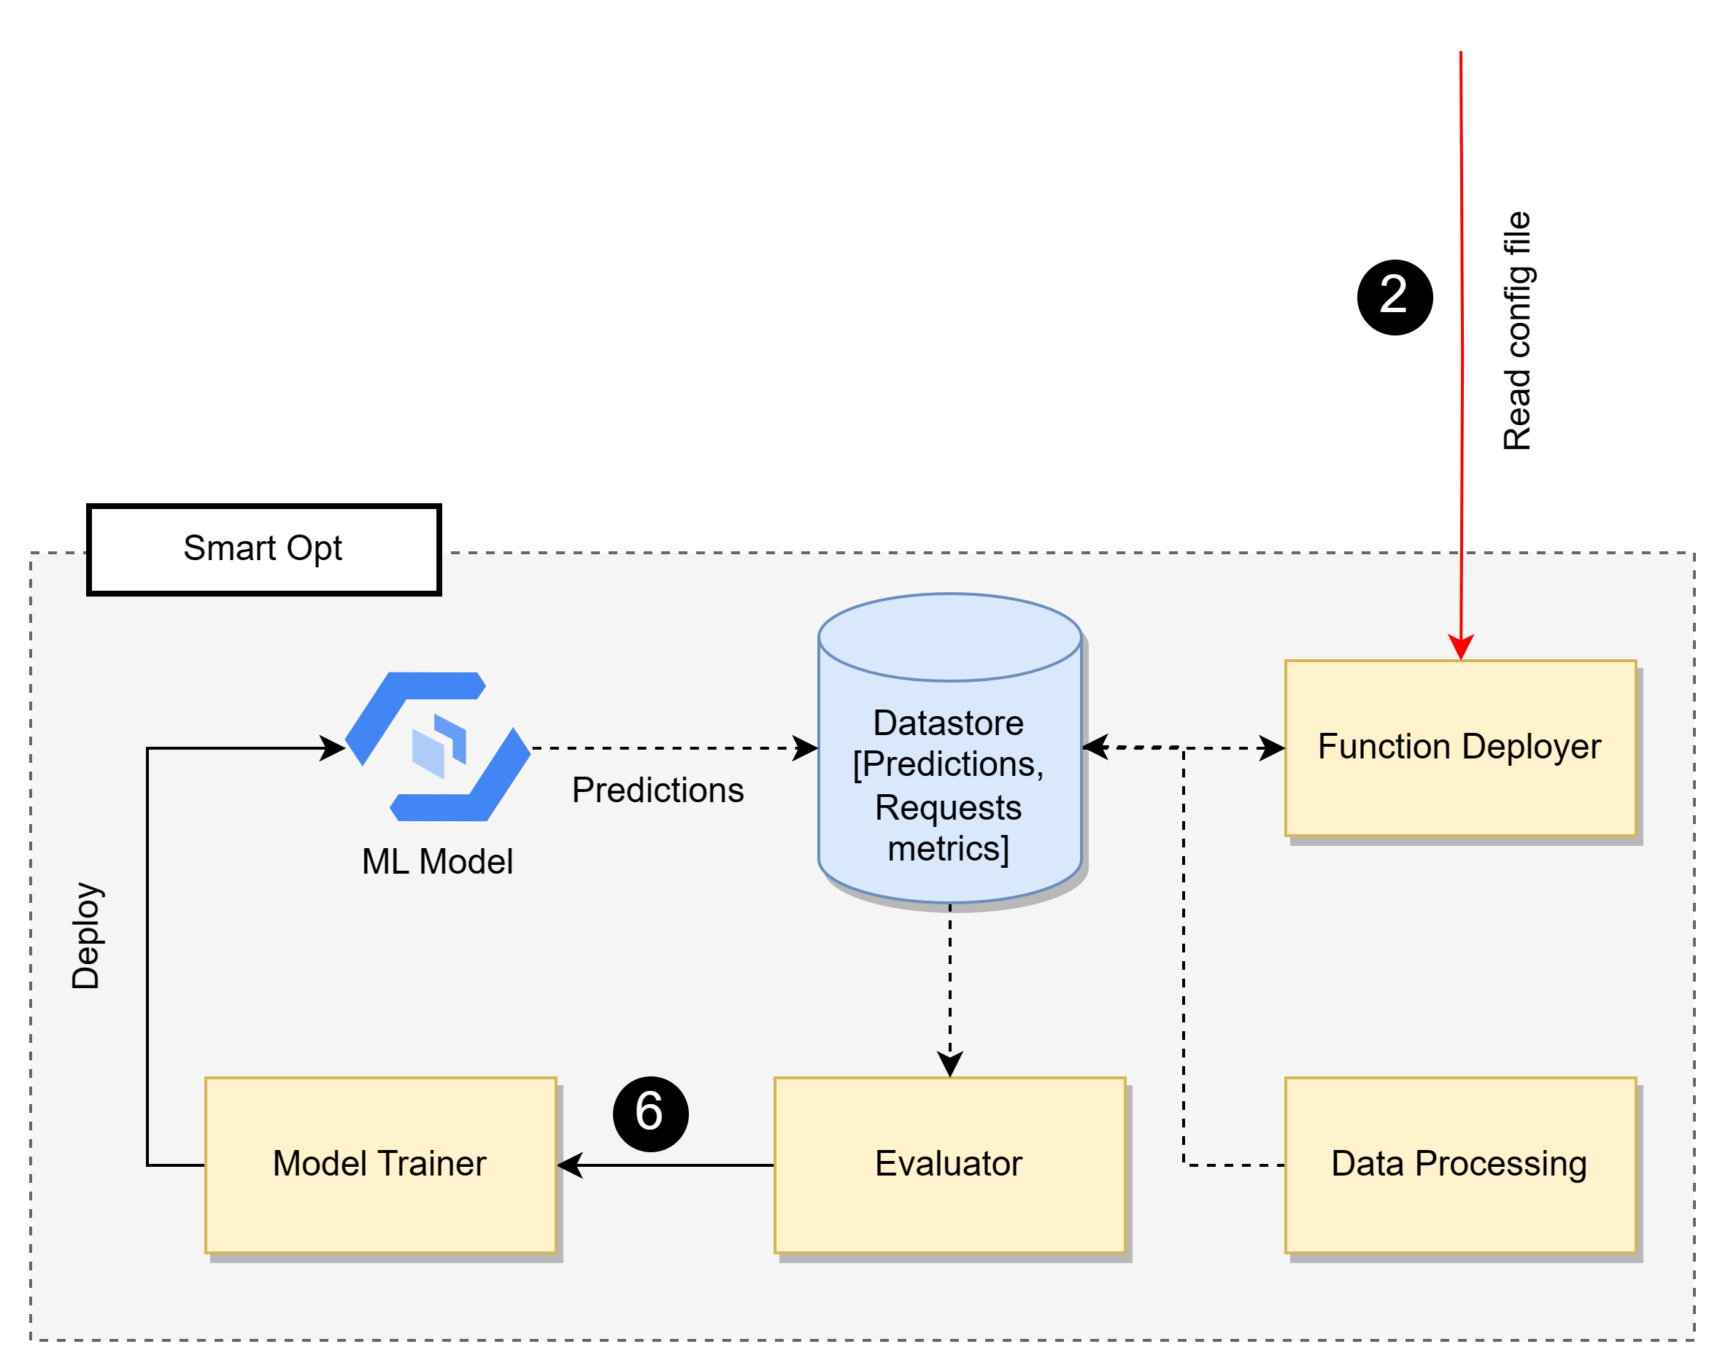
SmartOpt Architecture
Notes:
how to identify that the data is enough

Slide 25
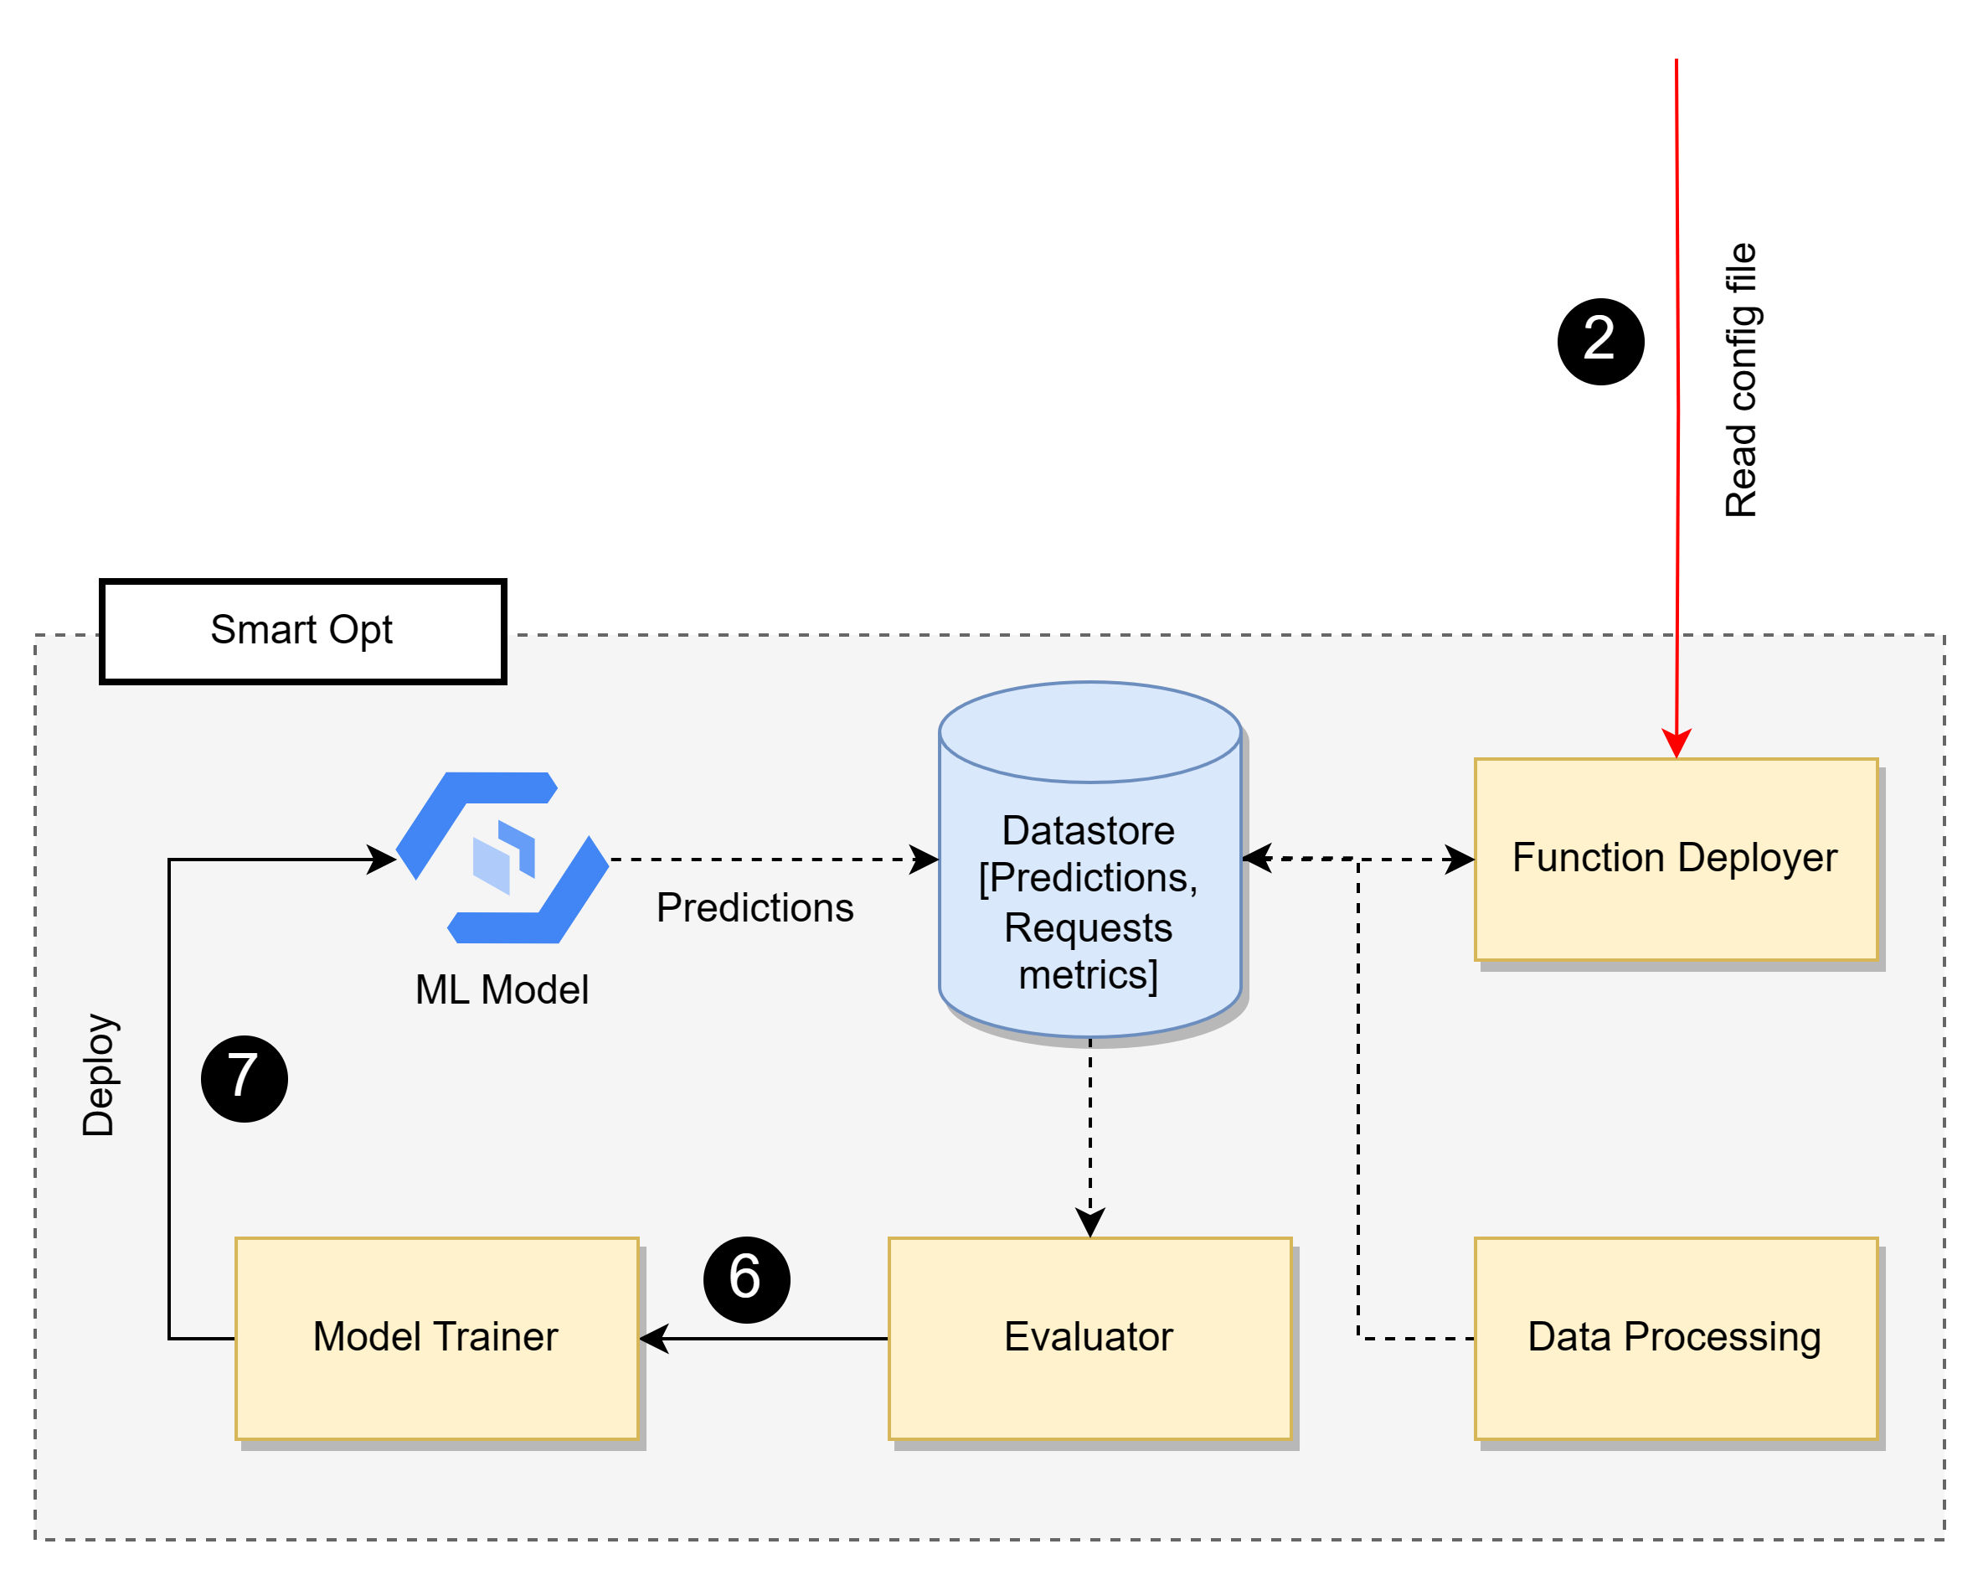
SmartOpt Architecture

Slide 26
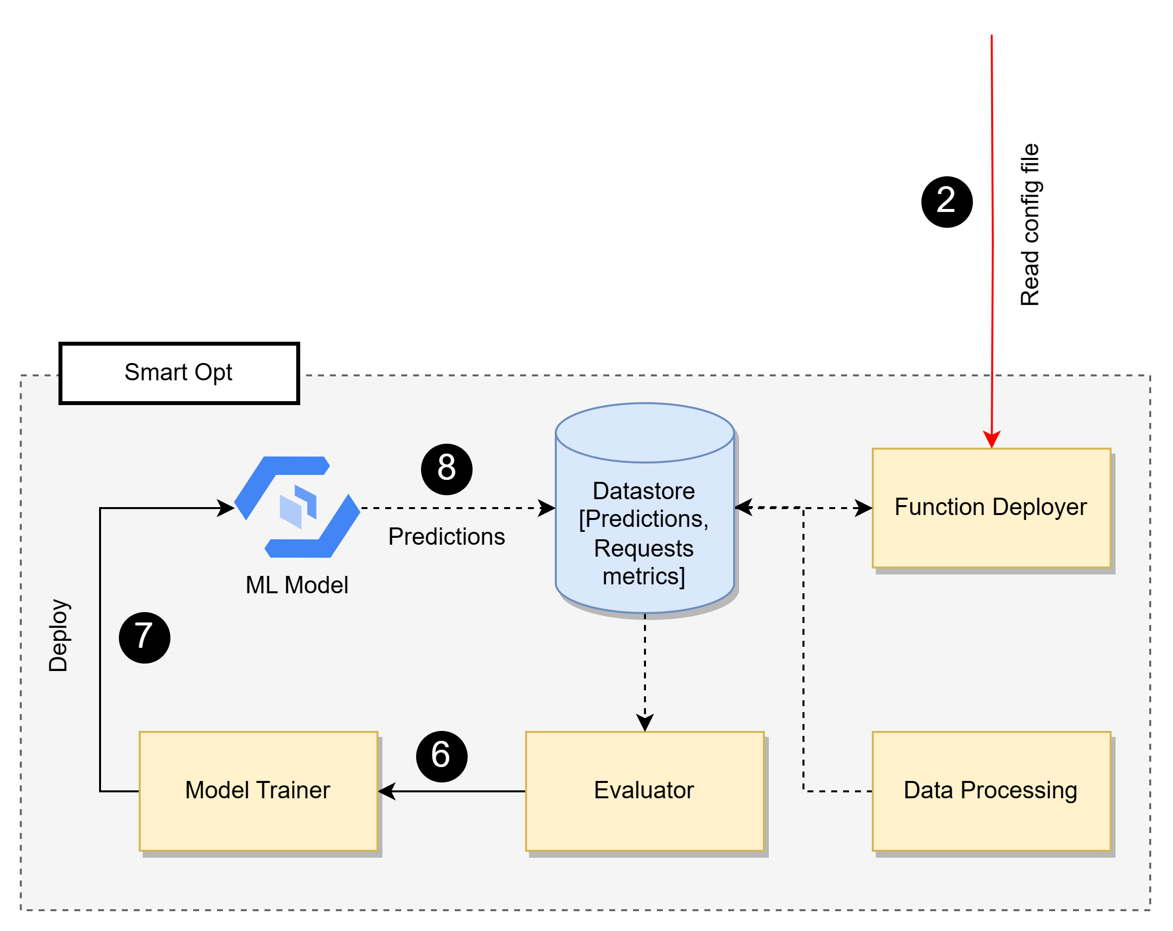
SmartOpt Architecture

Slide 27
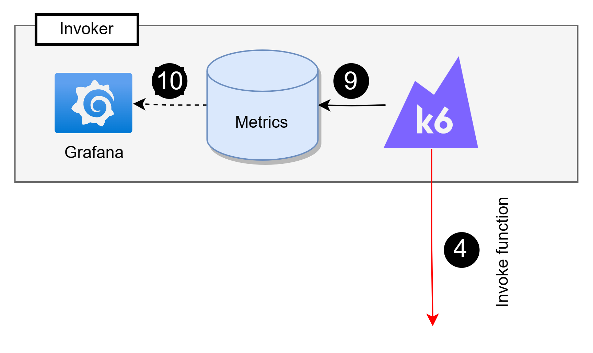
SmartOpt Architecture

Slide 28
Experiment Workflow
Describe about experiment workflow
Functions
Categories
Time period
Python functions and reason behind why those things were done
Why the strategies were chosen?

Slide 29
Functions Selections
12 Functions are selected and divided into 4 groups:
Category 1: (High No of Invocations, High Execution Time)
Category 2: (High No of Invocations, Low Execution Time)
Category 3: (Low No of Invocations, High Execution Time)
Category 4: (Low No of Invocations, Low Execution Time)

Slide 30
Strategies Evaluated
Strategy | Description
Strategy 1 | Native Knative Implementation with default Knative Pod Autoscaler (KPA) settings.
Strategy 2 | Native Knative Implementation with KPA and concurrency level as 1.
Strategy 3 | SmartOpt with a statistical ML model set as Fast Fourier Transform is used along with KPA in Knative. In (Concurrency determining) Algorithm 1, minimum response time is used.
Strategy 4 | SmartOpt with deep learning model set as N-BEATS is used along with KPA. In (Concurrency determining) Algorithm 1, minimum response time is used.
Strategy 5 | SmartOpt with deep learning model set as N-BEATS is used along with KPA. In (Concurrency determining) Algorithm 1, average response time is used.

Slide 31
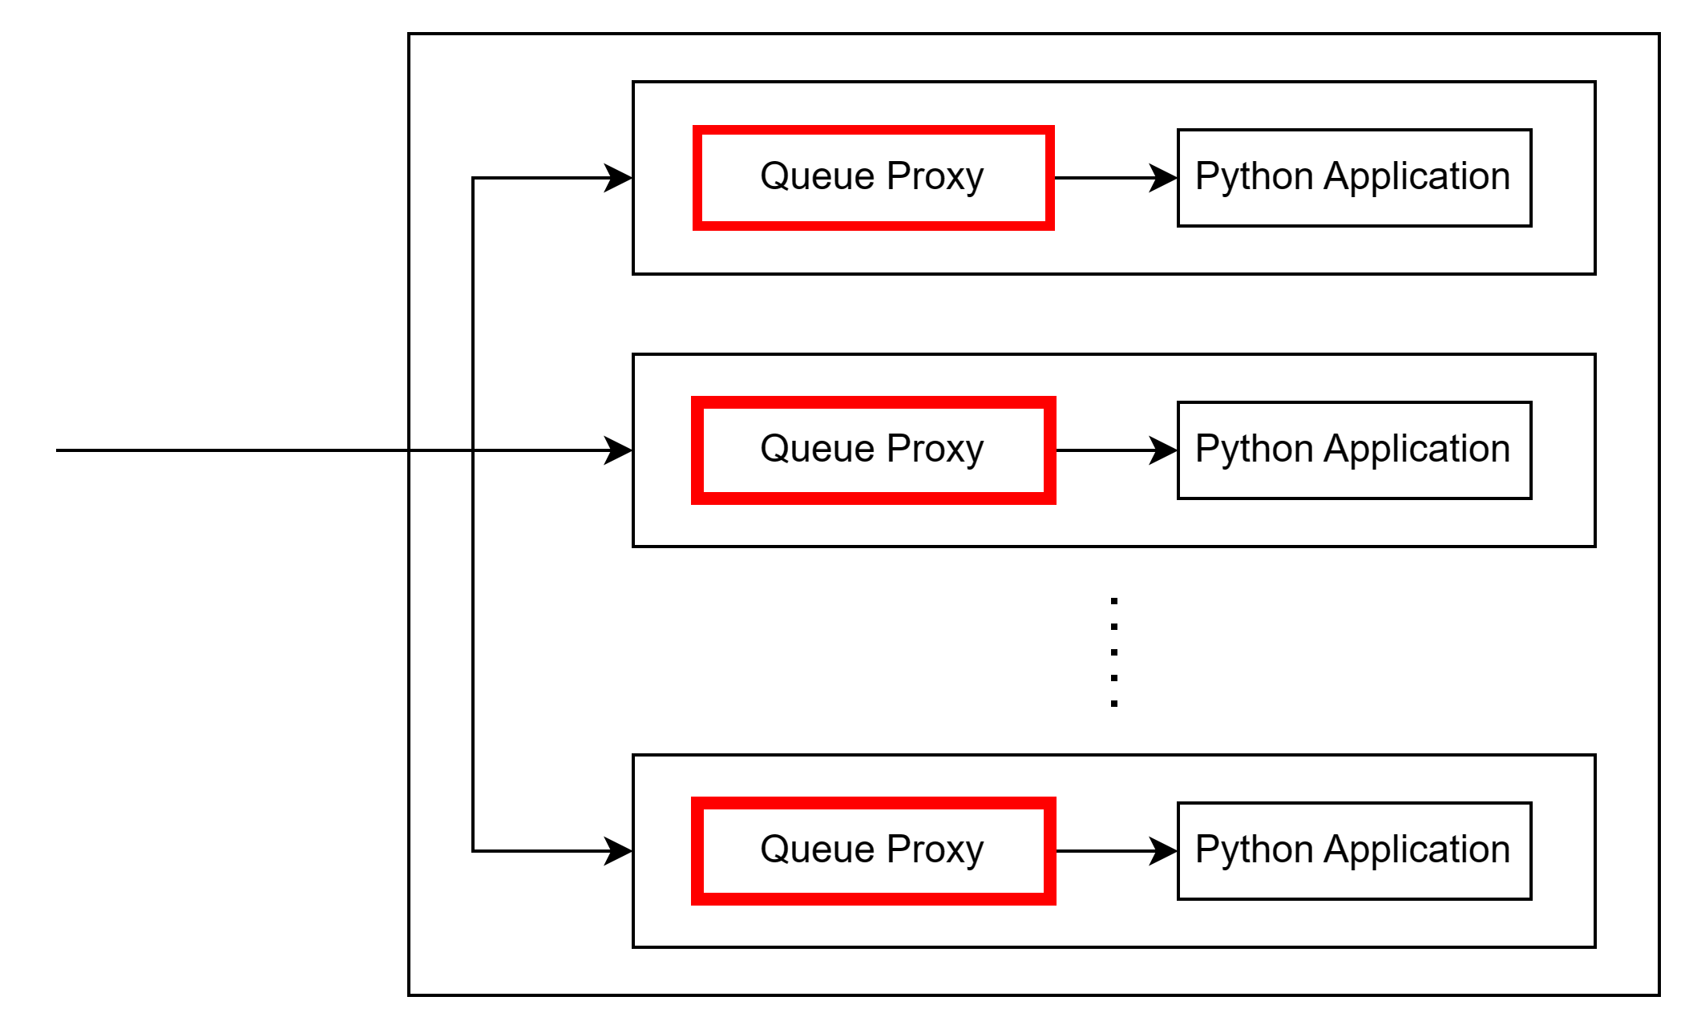
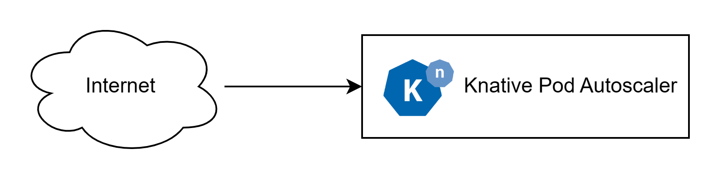


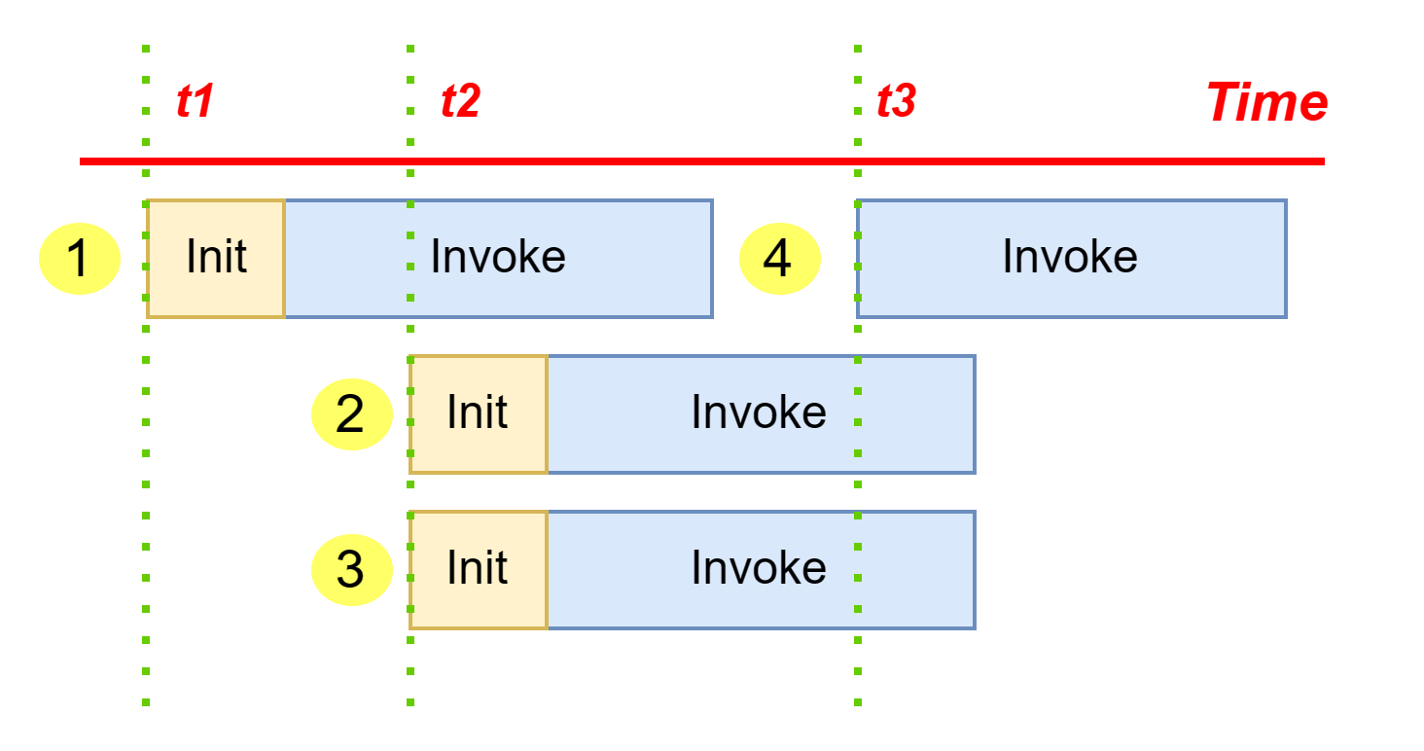
Requests Flow in Knative
Notes:
The Queue-Proxy is a sidecar container. When you submit a Service or Configuration,
Knative adds the Queue-Proxy to the Pod. Queue proxy set as 1 means only 1 request is allowed to be flown at the revision
Request would be waiting in that queue.

Slide 32
Evaluation Criteria
Response time of requests
Total requests fulfilled and the number of requests dropped.
Total containers active during the 15 minutes time interval for each test.
Total estimated costs required for each test.
Total number of SLO (Service Level Objectives) breached.
32

Slide 33
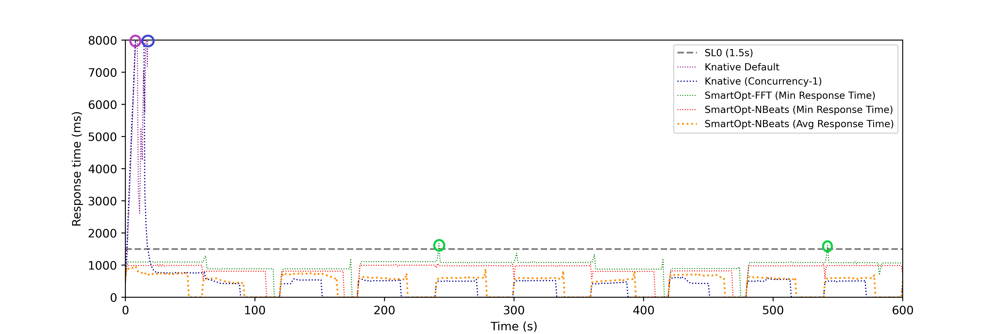
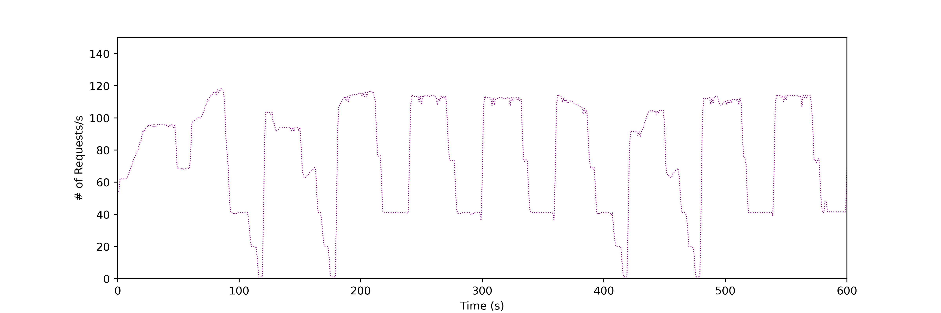
Response Time – Category 1
Fig 1: Response Time (J)
Fig 2: User Requests Pattern

Slide 34
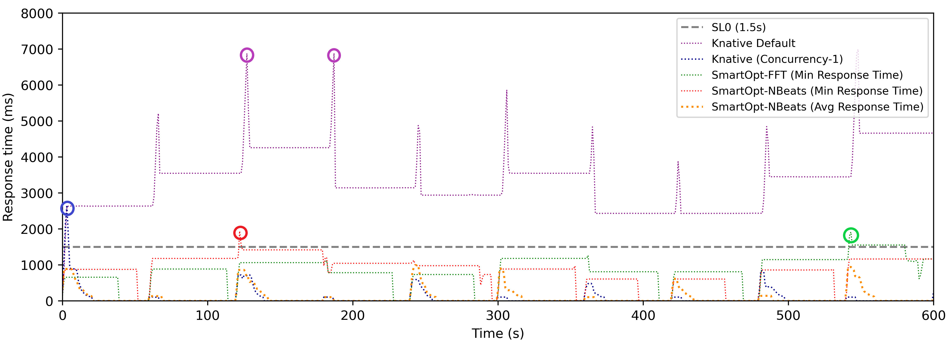
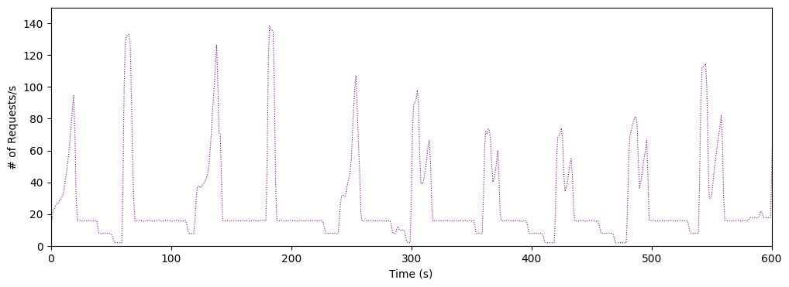
Response Time – Category 2
Fig 1: Response Time (H)
Fig 2: User Requests Pattern

Slide 35
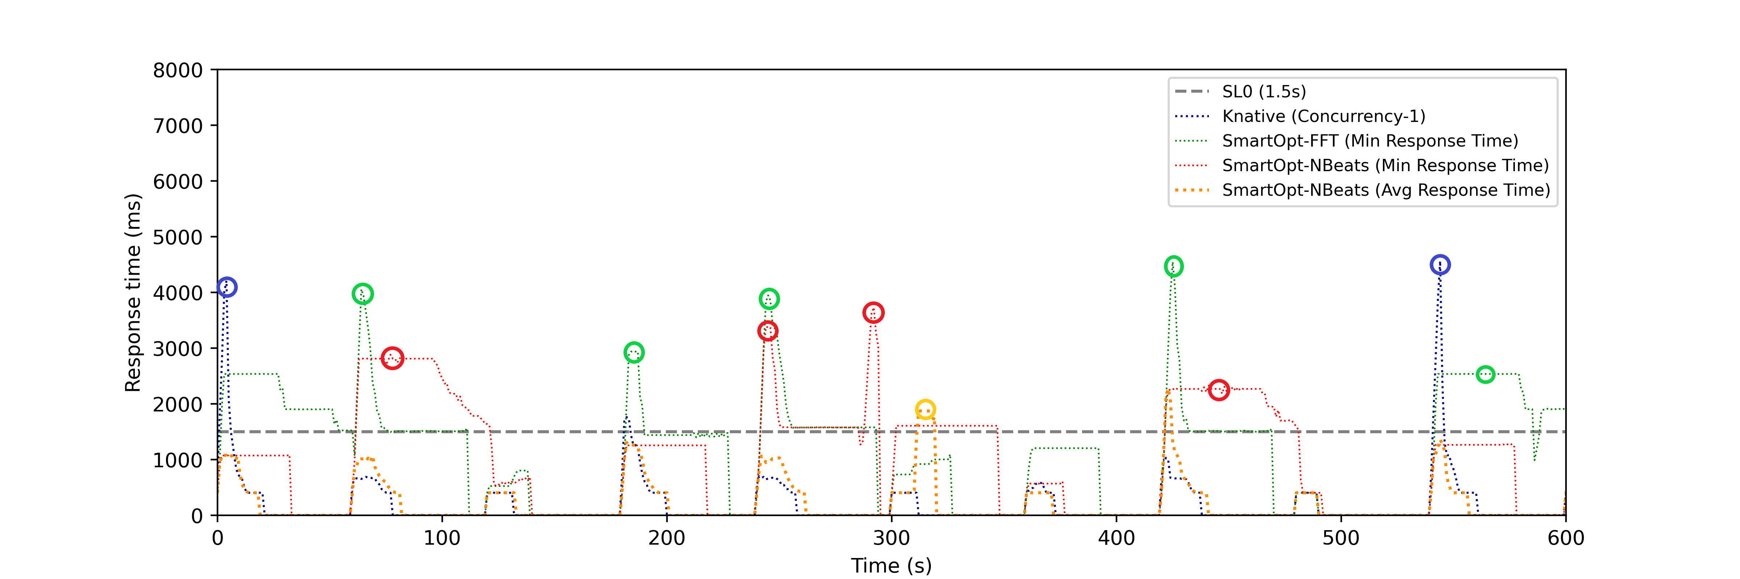
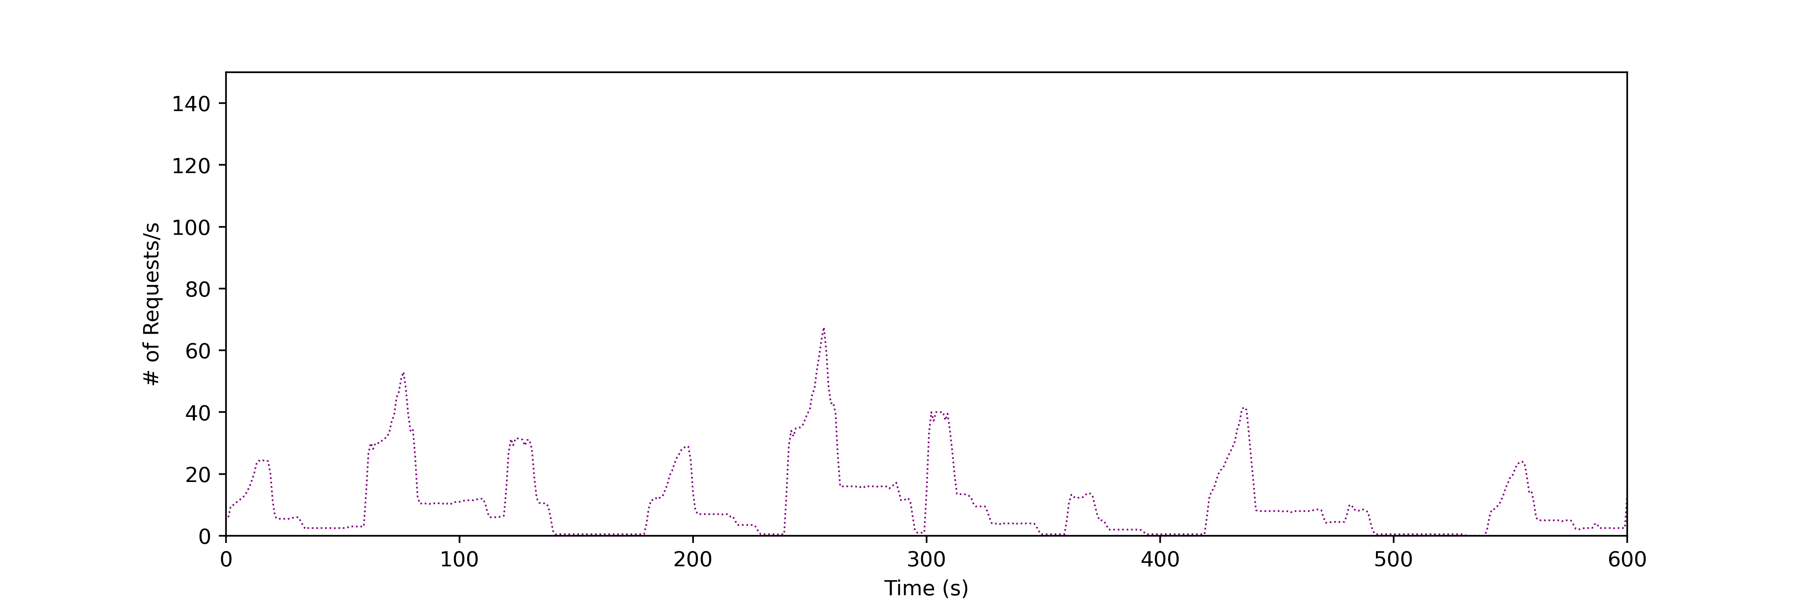
Response Time – Category 3
Fig 1: Response Time (E)
Fig 2: User Requests Pattern
Notes:
Removed Knative default from the graph

Slide 36
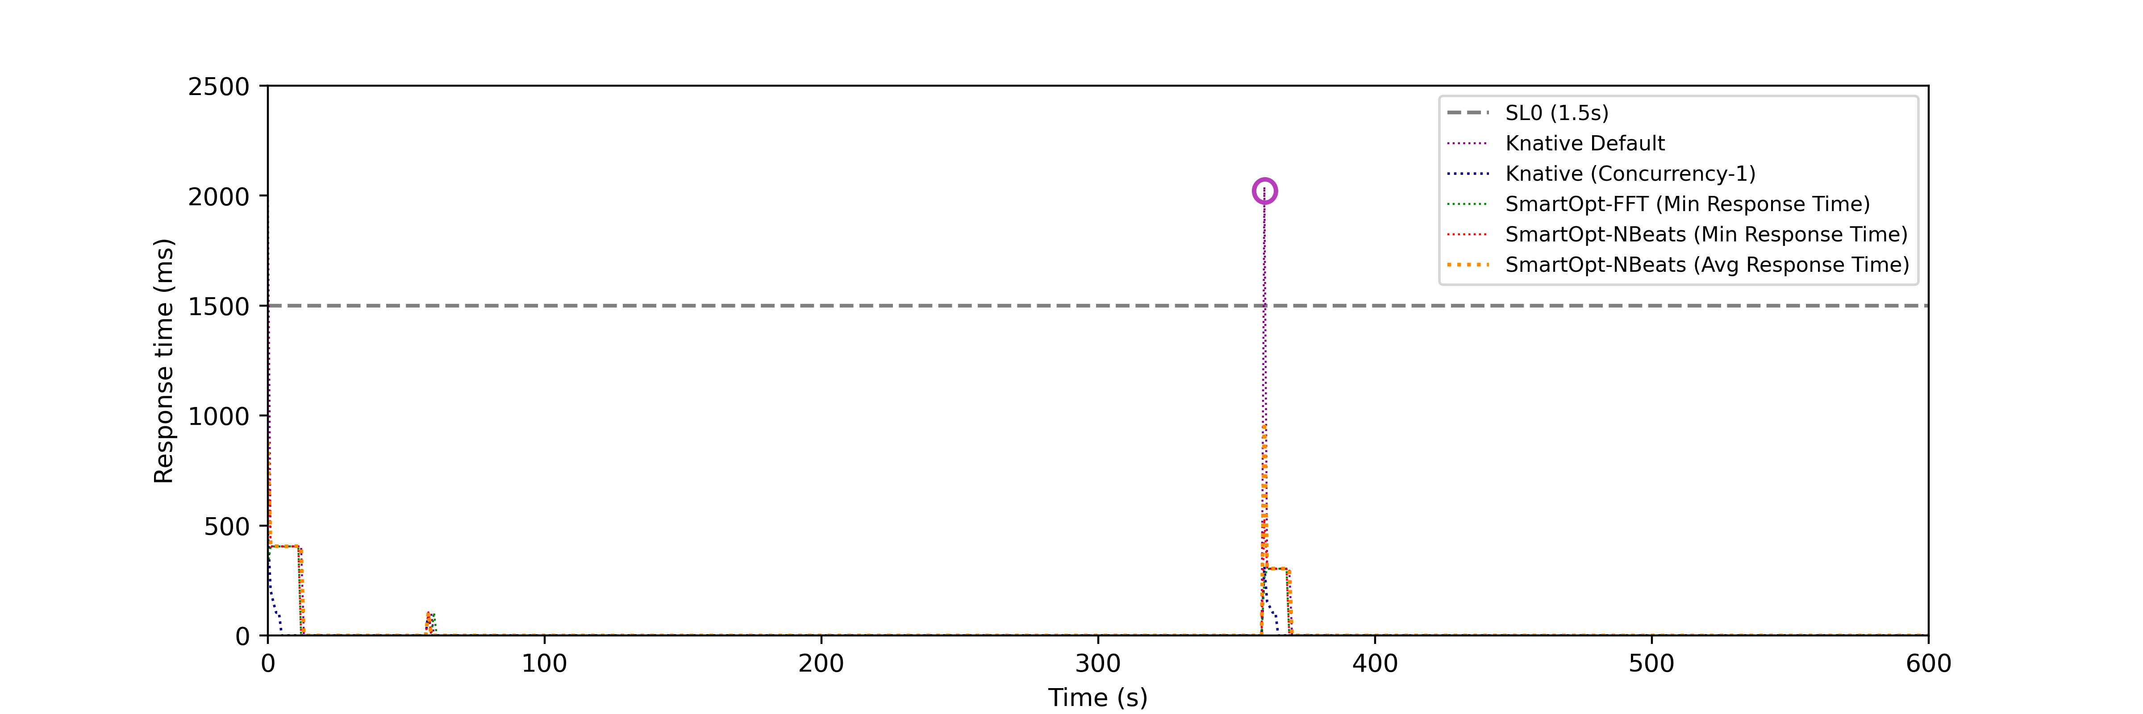
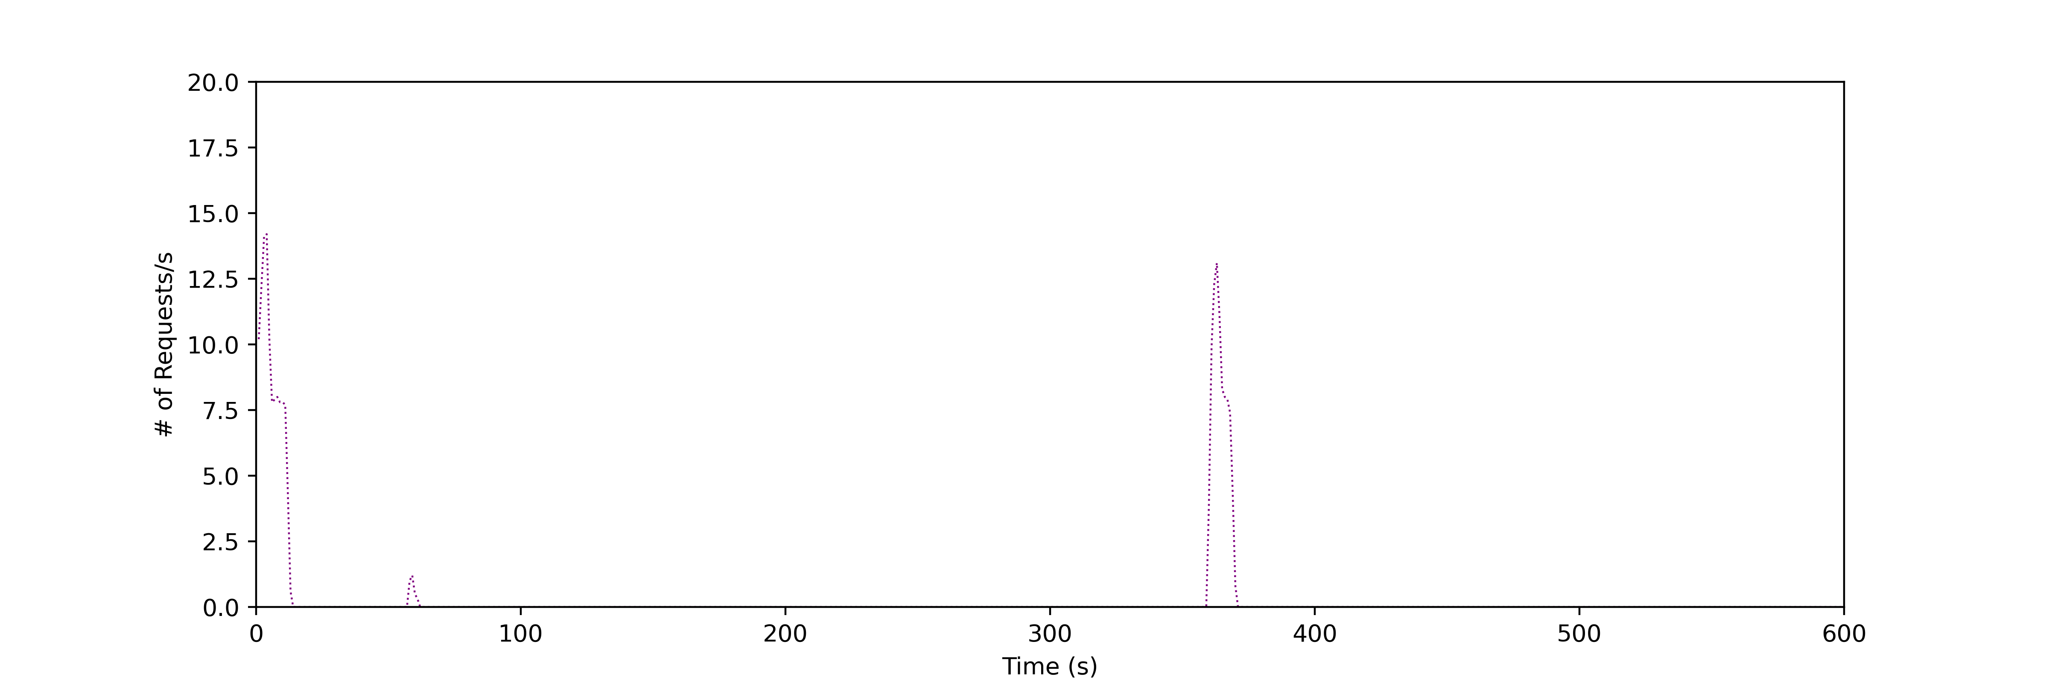
Response Time – Category 4
Fig 1: Response Time (J)
Fig 2: User Requests Pattern

Slide 37
Response Time Metrics

Slide 38
Response Time Metrics

Slide 39
Total Requests Served

Slide 40
Experiment Costs Estimates

Slide 41
SLO Violation

Slide 42
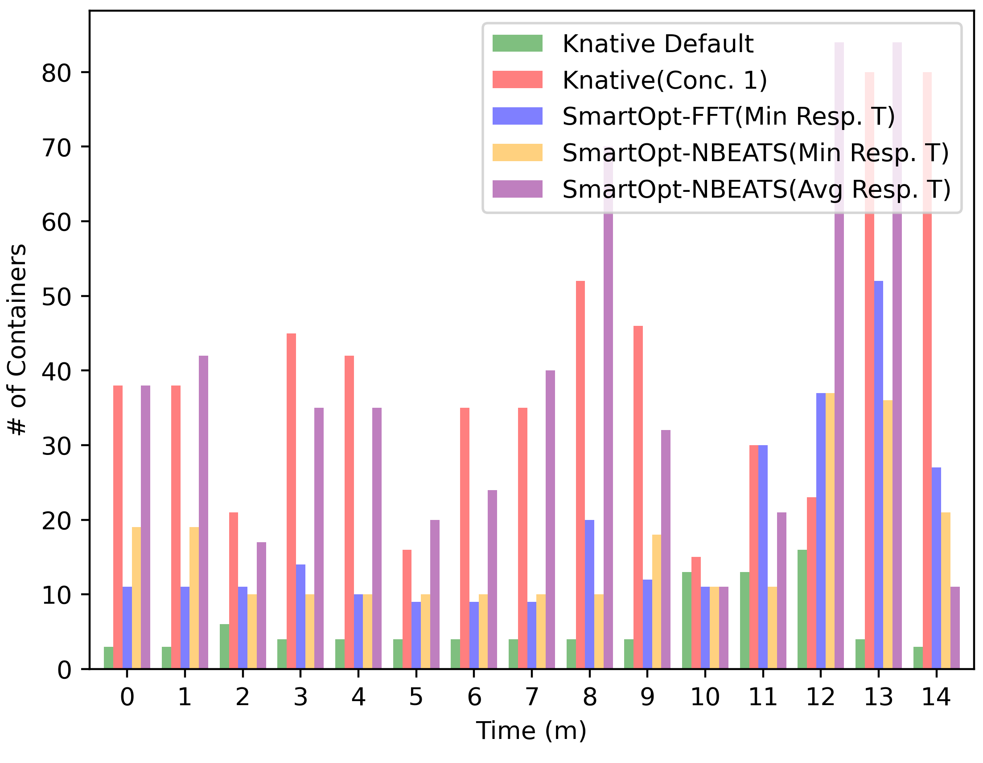
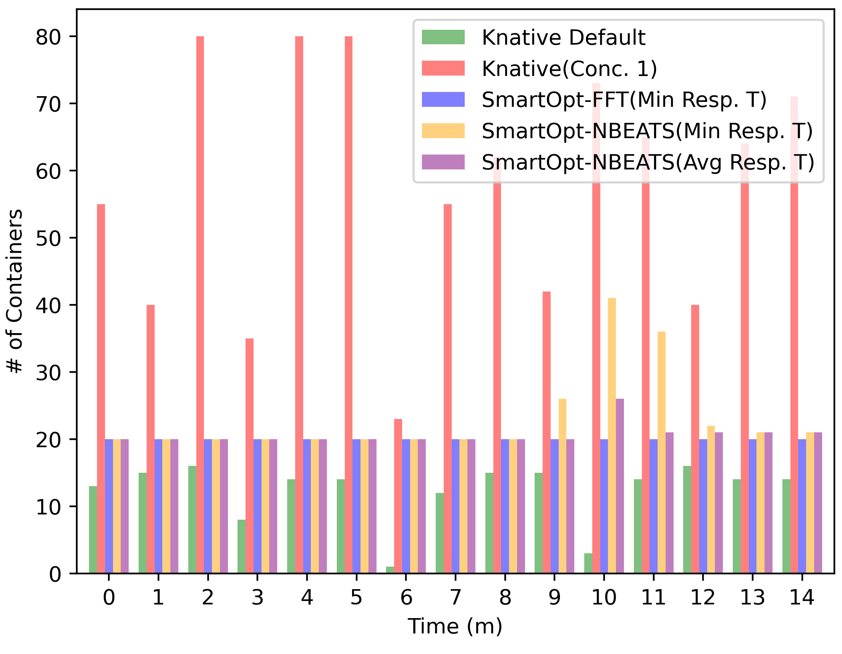
Container
Fig 1: Category 1 (J)
Fig 2: Category 2 (G)

Slide 43
Conclusion
Which thing worked best

Slide 44
Future work
Integrate the utilization level of containers as an additional parameter in our tool to further improve the creation of a configuration policy for the functions.
Resources for the pods like vCPU and Memory were fixed during our experimentation. Need to evaluate the impact of these resource changes on the function's performance.
Due to budget constraints scaling of functions was set max at 80 which can be increased for functions which have very high invocations.
Notes:
container resources like memory and
CPUs on the performance of the functions. In our work, we have fixed these resources for all
containers to evaluate our tool

Slide 45
Thank You!

Slide 46
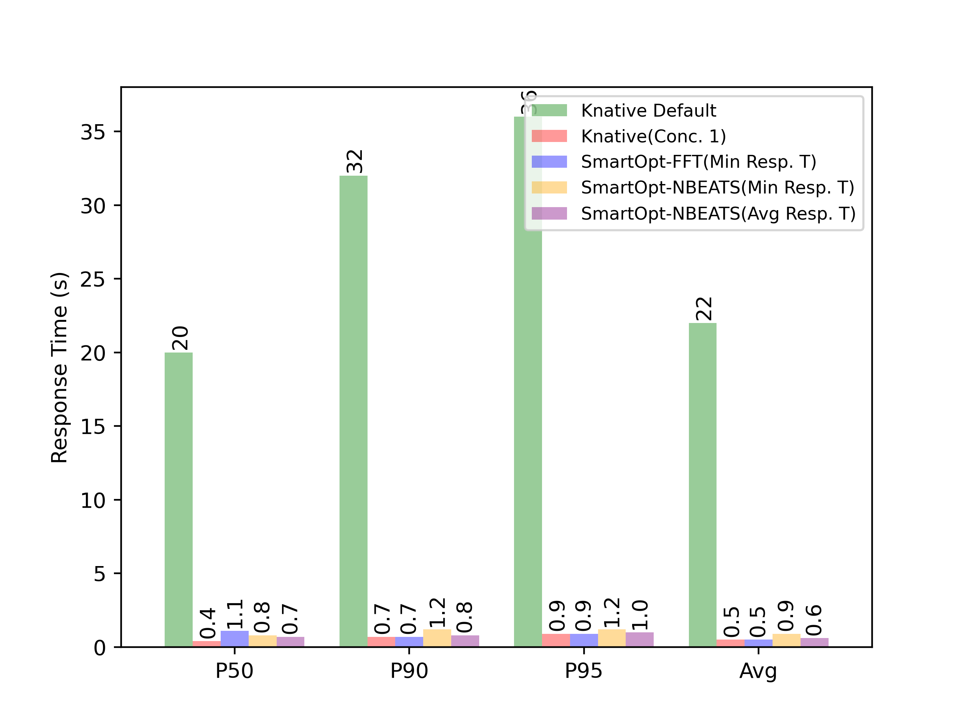
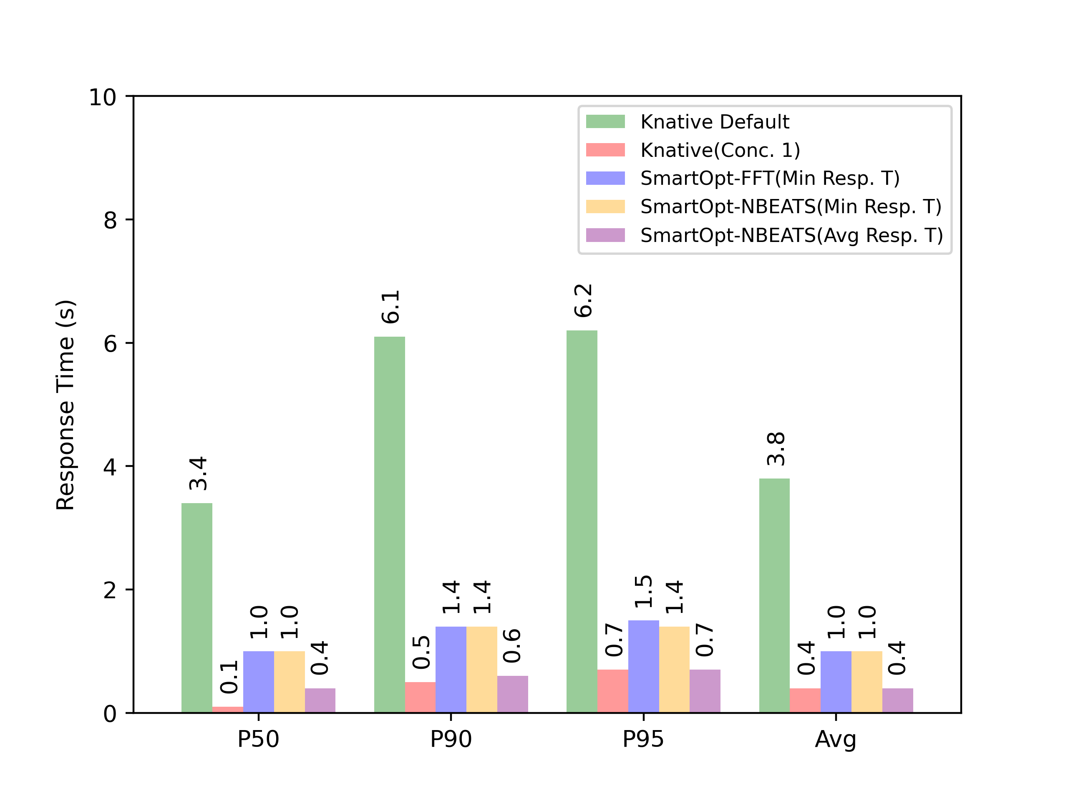
Response Time Metrics
Fig 1: Category 1 (J)
Fig 2: Category 2 (H)

Slide 47
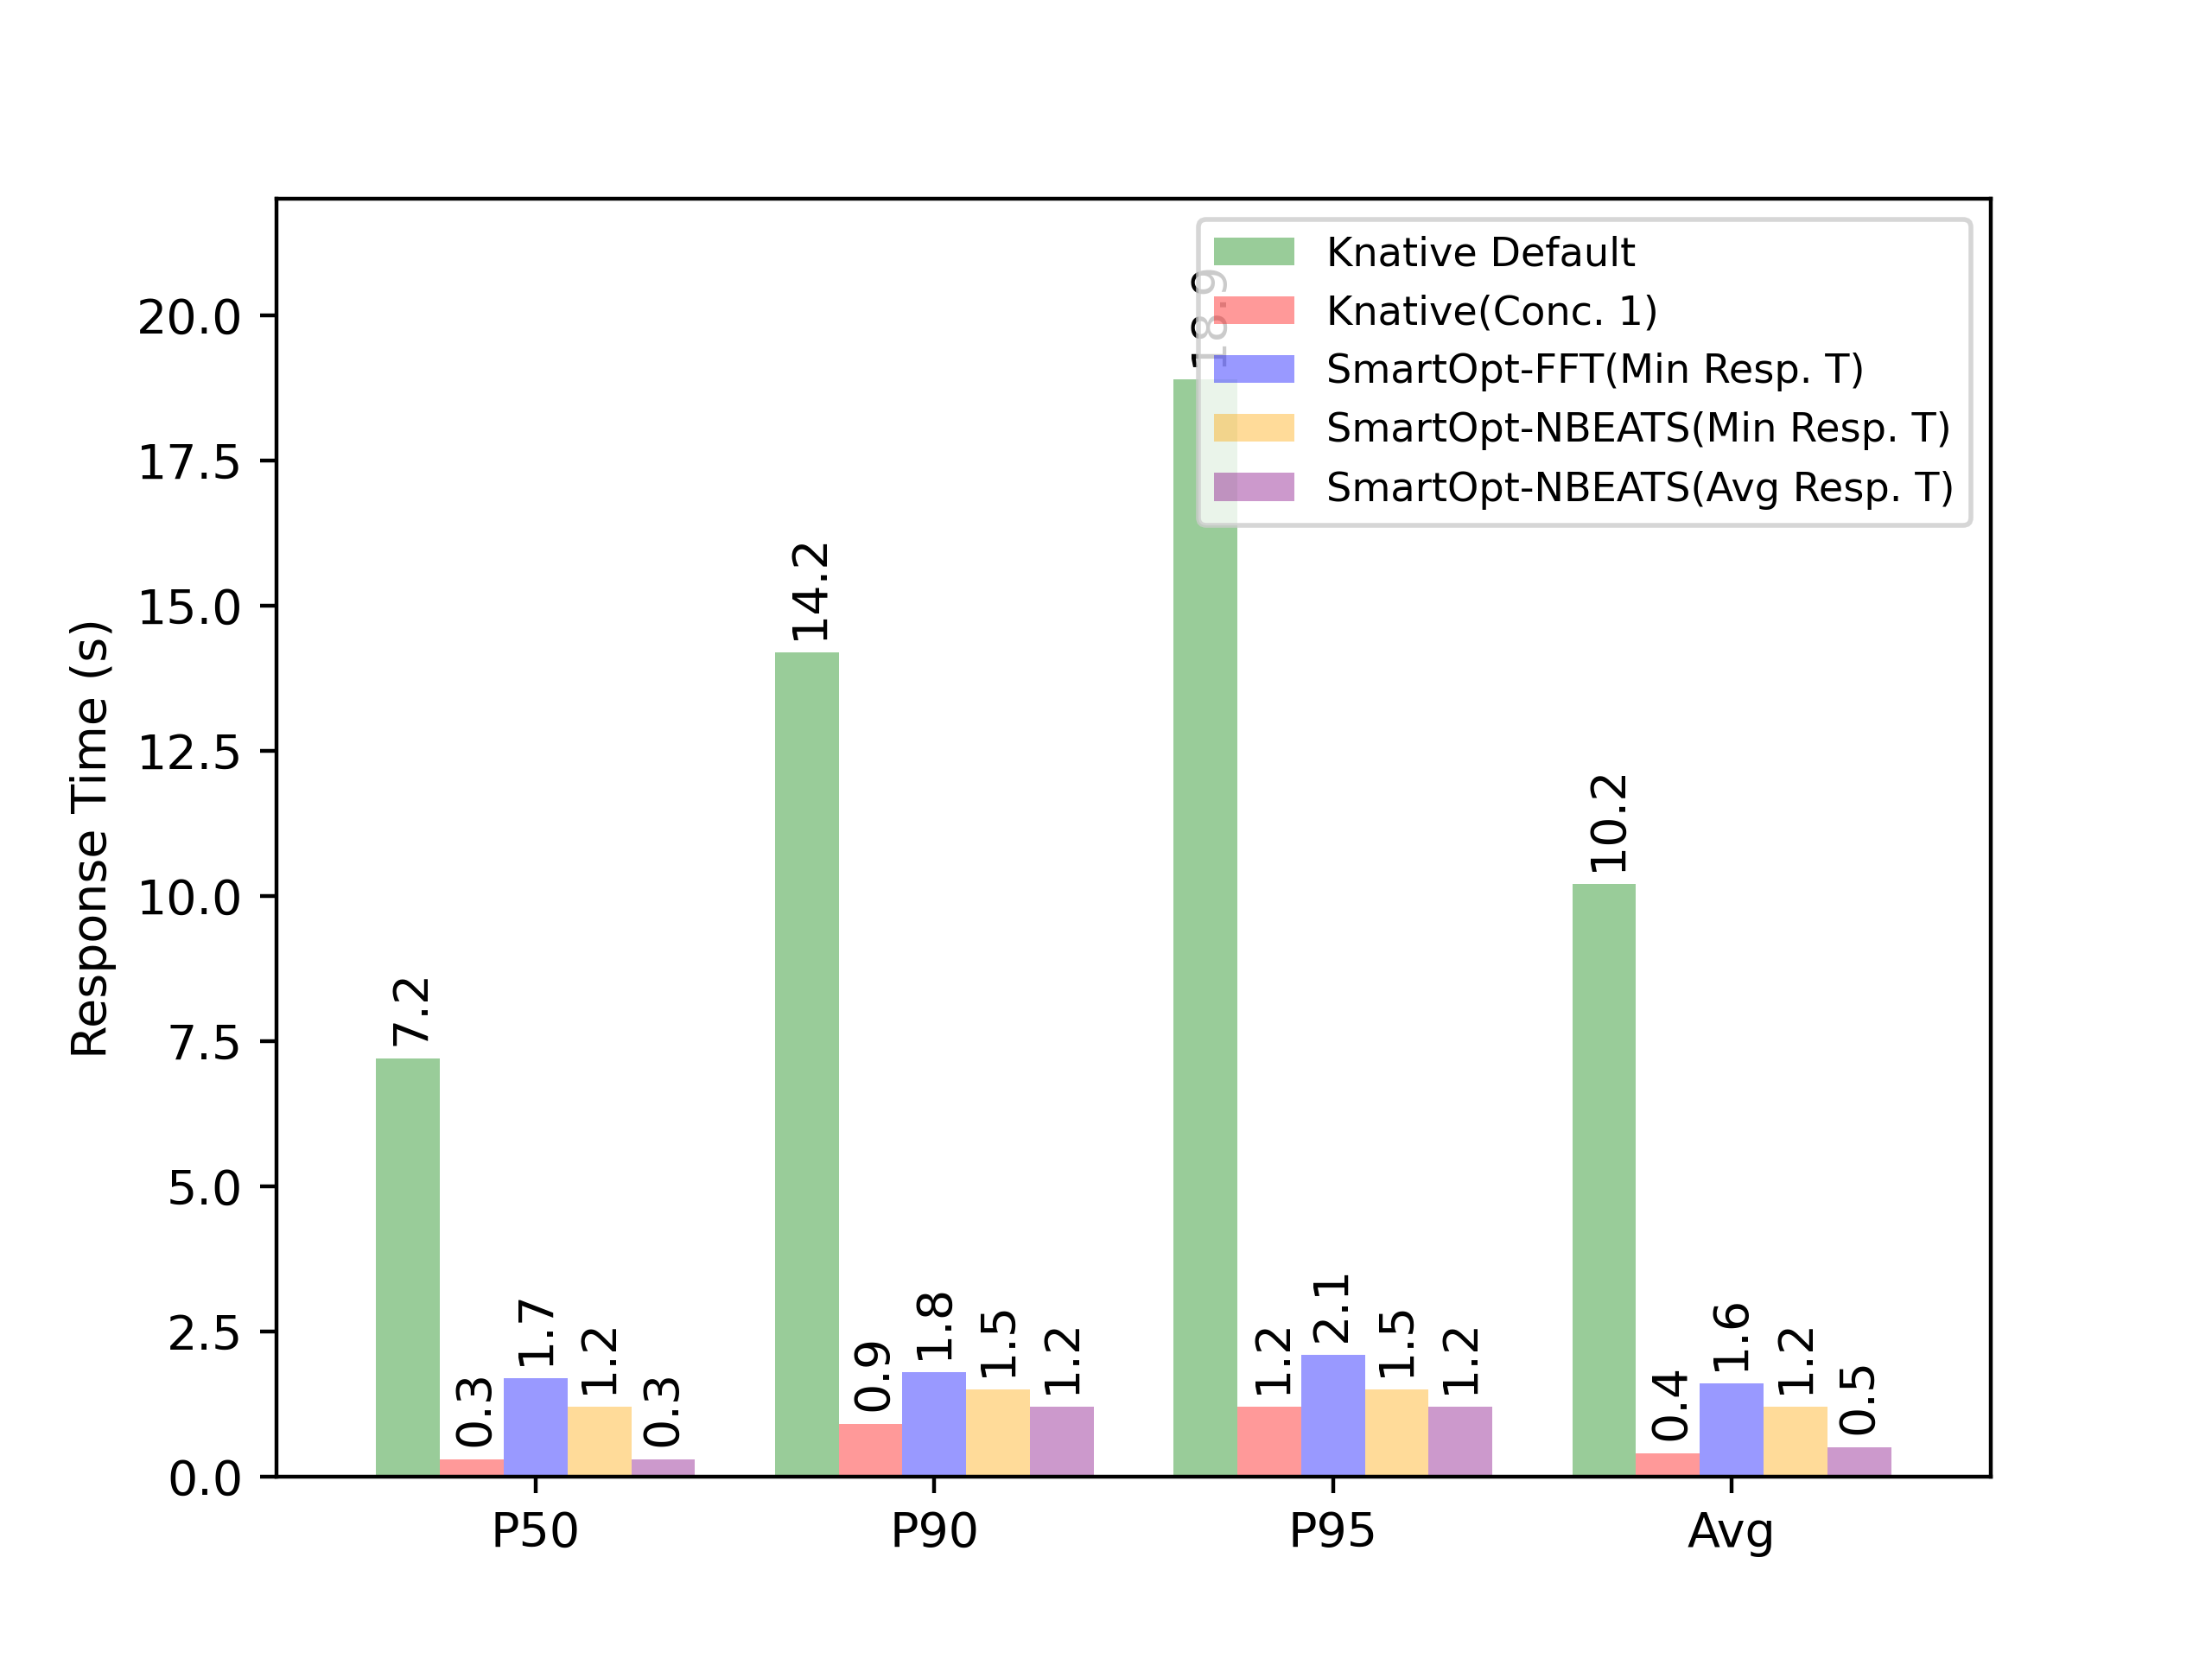
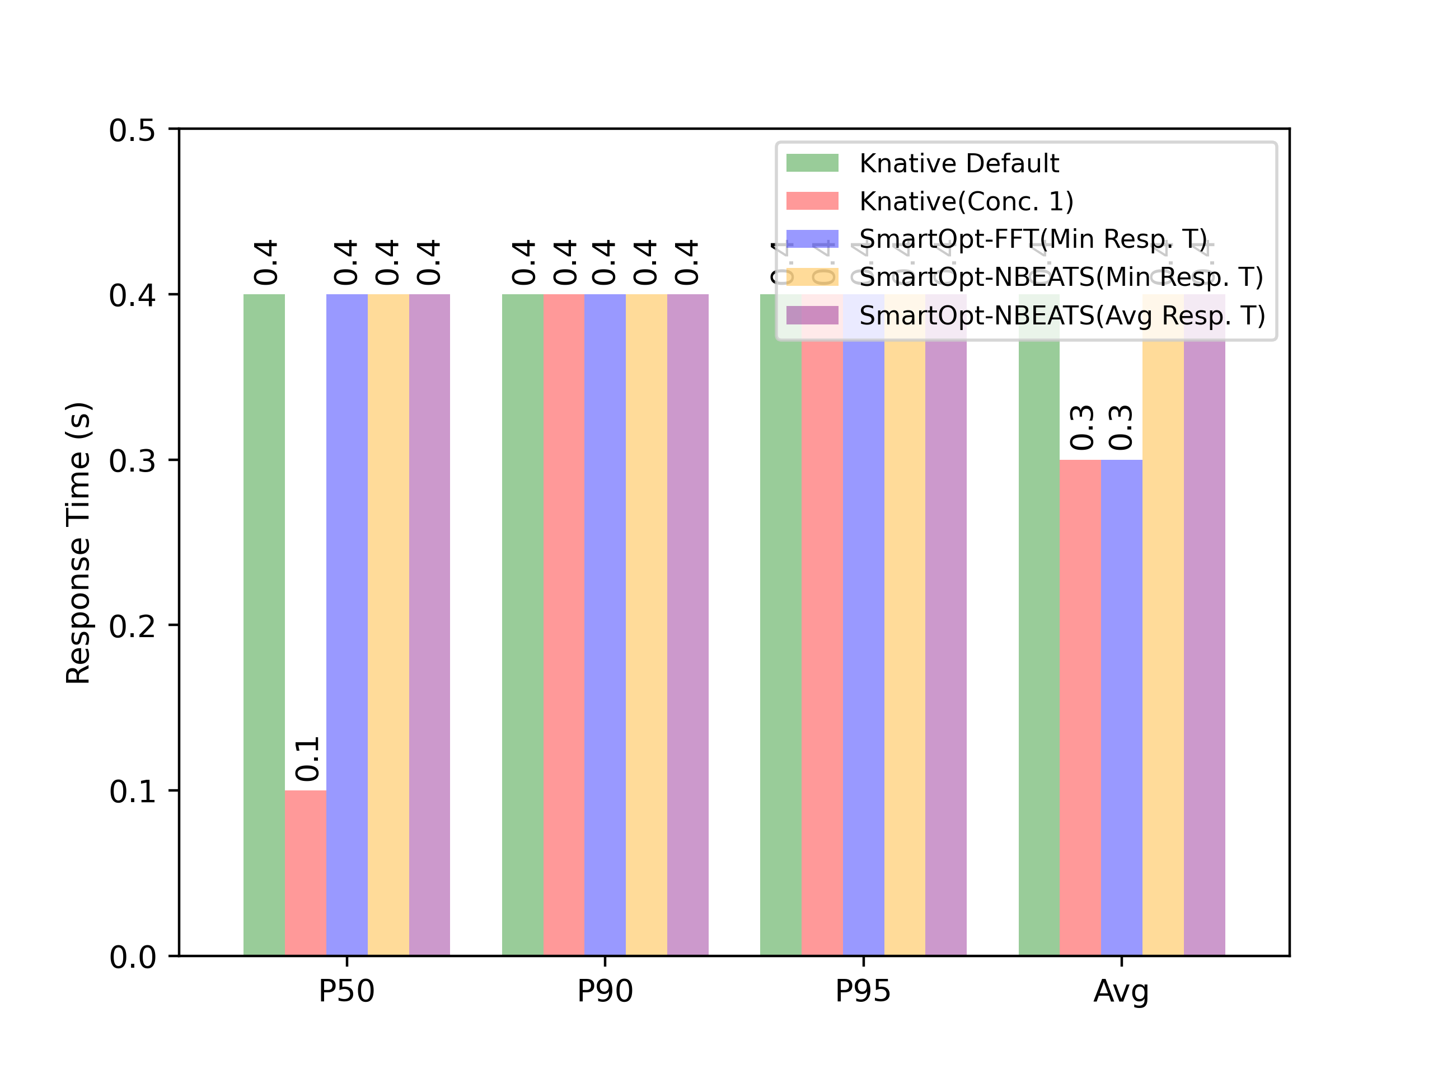
Response Time
Fig 1: Category 3 (E)
Fig 2: Category 4 (B)

